Slide 1
Dry Fork Station Contractor Safety & Environmental Orientation
Updated: 2026

Slide 2
Follow OSHA Safety Guidelines
This orientation covers general plant rules and is not considered safety training.​ ​
Contractors must follow all applicable OSHA Safety Guidelines. ​ ​
Employers must provide all the safety training needed for your site work.

Slide 3
Contractor Classification
Class “A” - Construction / Maintenance Contractors ​
Contractors involved in the construction or maintenance at Owner’s facilities; in addition, any contractor that will be signing on to a clearance or a confined space. In addition, any consultants, trainers, engineers and service representatives or technicians who will be performing “hands-on” work.
Class “B” - Incidental Contractors ​
Contractors who are at Owner’s facilities for a limited or brief period of time such as vending machine repair, copier repair, janitorial services and other services whose work does not involve or influence process/operating equipment. Contractors within offices, lunchrooms, or control room areas performing cosmetic maintenance tasks and minimal maintenance of parking lots. Also includes consultants, trainers, and engineers and service representatives / technicians whose work is “hands-off”. ​​
Class “C” - Delivery - Class C contractors must be designated as C.1 or C.2 ​
Class C.1 - chemical and fuel deliveries - for gasoline, diesel, fuel, propane, anhydrous ammonia, chlorine and other chemicals. ​
Class C.2 - freight deliveries - including equipment, coal, dirt, gravel, rock and concrete.

Slide 4
Subcontractors
If a contractor brings a subcontractor on-site, they are considered the same class as the contractor and are must follow the same standards. (facial hair, FR clothing, etc.)
All contractors and subcontractors must attend this site orientation annually before starting work initially.
Fired employees must be escorted to the gate and reported to the On-Site Coordinator.

Slide 5
Site Rules
See General Safety and Environmental Rules Form SAF-6051.
Read through and sign the last page. This form will need to be submitted for plant access.

Slide 6
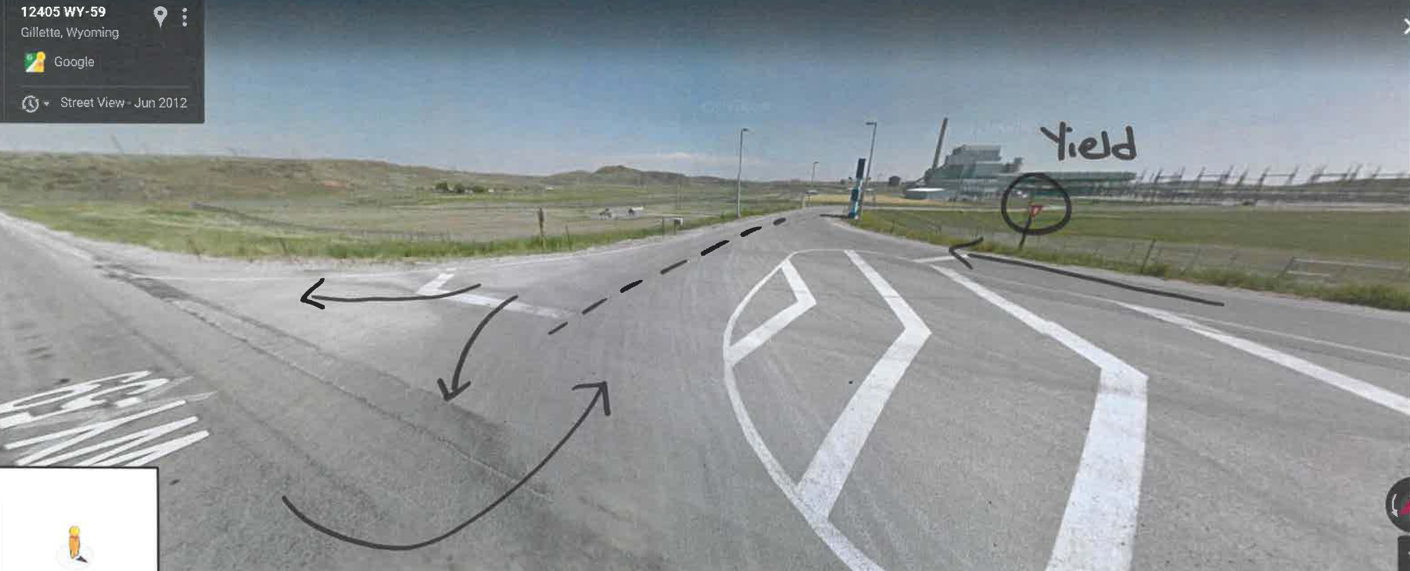
Site Access
With the traffic on the highway coming from the North with no turn lane and 70mph speed limit, traffic coming into the plant from the South must yield to those coming from the North. Please adhere to this abnormal traffic sign.

Slide 7
Badging Requirements
Contractors must turn in their completed training forms for all employees coming on-site, to their On-Site Coordinator to obtain a badge.
Prior to the start of work
JPEG pictures can be sent with training documents to have badges printed ahead of time.
If not, schedule with admin to get badges made.
Badges will be given to the contract foreman/safety to be given to employees at the turnstiles at the start of work.
All badges will be turned into the On-Site Coordinator once the work is complete.
When badging in the small badge reader is for badges and the large badge reader is for vehicle passes when accessing the plant at the delivery gates.
DO NOT let someone else use your badge!

Slide 8
Parking & On-Site Access
Must have vehicle permit.
Company vehicle must have identification, fire extinguisher and insurance to be allowed on-site.
Must be used for work, no personal vehicles allowed on-site.
Drop tools off
Haul equipment
Contractors shall park in the contractor parking lot outside the gate (gravel lot) and enter through the turnstiles.
Must park in designates parking spots when on plant site.
EVERYONE in the vehicle MUST badge in and out when going through the gate.
Once individuals come through the turnstiles and/or gate PPE is required.

Slide 9
Driving on Plant Site
Seat belts are required in all vehicles and equipment for all drivers, operators, and passengers.
Riding in the bed of a pickup or flatbed is not permissible.
Headlights must be turned on when driving on the plant site.
All vehicles/equipment will briefly sound their horns before entering a blind corner or bay.
While operating a motor vehicle or equipment, stop and pull over to text or talk on plant site.
Radio is allowed for ground control operations
Texting while driving is against the law in the state of Wyoming

Slide 10
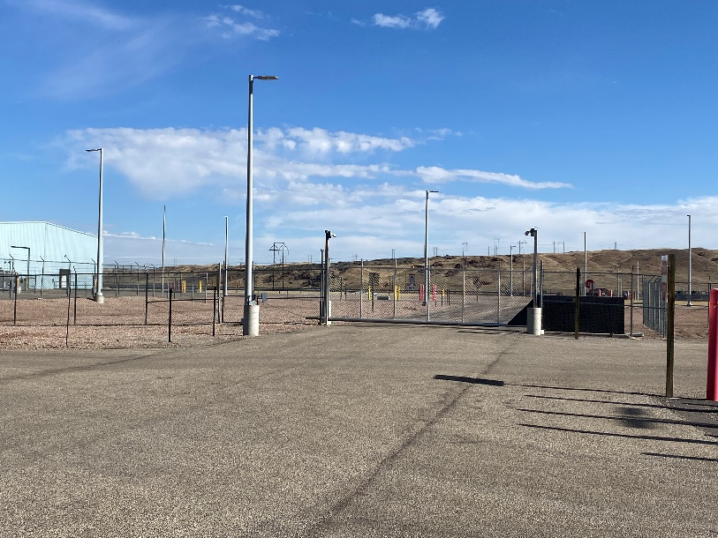
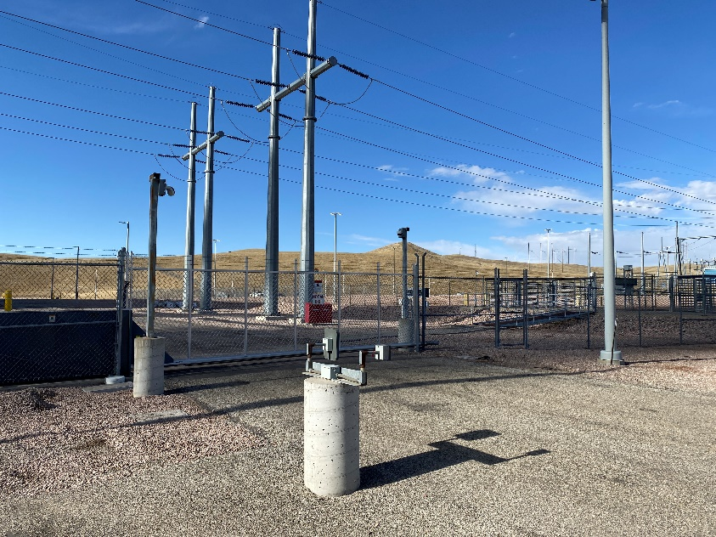
DFS Employee Parking Lot
North and South Admin gates to plant are not to be used by contractors unless the On-Site Coordinator has given special permission. (these are the gates that lead to DFS employee parking lots.)
North Gate
South Gate

Slide 11
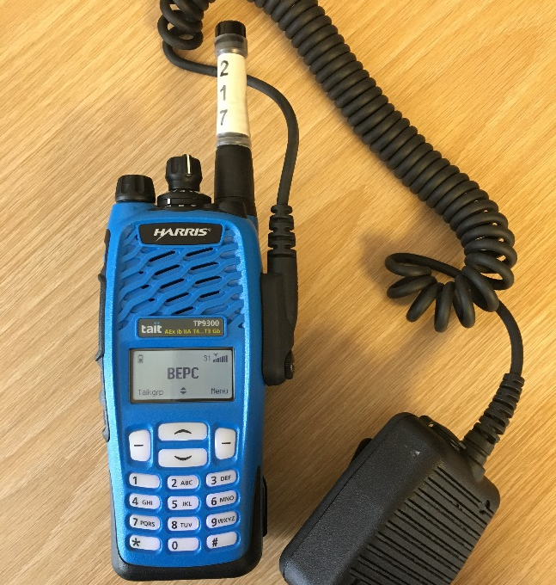
Radios
Orange button and blue button on top – May Day to HDQ
Alert Channel 1 – Emergencies
Turn in radios and chargers to the On-Site Coordinator or outside the Control Room on the counter at the end of work.

Slide 12
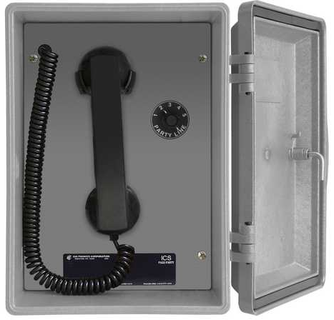
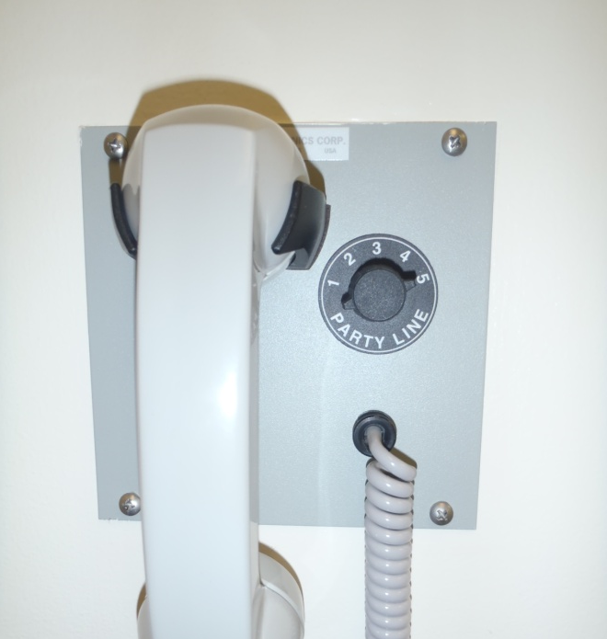
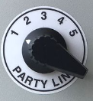
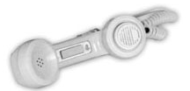
Gai Tronics
Channel 1 Emergencies Only
Channel 2-4 General Use
Channel 5 Access from a desk phone
To Use
Push button on handset ​ to page over plant speakers.​
Release handset button to listen and talk on the line the dial is turned to.​
When answering a page, just pick-up the handset and choose the line# on the dial, but don’t press button.​
Use the knob to choose the line #.​
Do Not Misuse or abuse

Slide 13
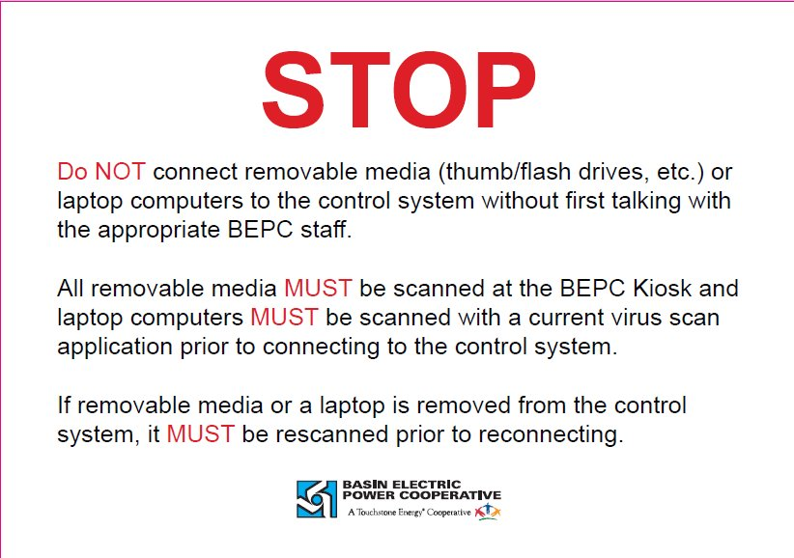
Use of Removable Media
Shall be discussed with plant E&I techs prior to use.
Shall be scanned by plant E&I techs each time prior to connecting to any plant computers or control systems.

Slide 14
Smoking
Lit cigarettes and the use of e-cigs or vaping of any kind is NOT PERMITTED in: ​
Any indoor area !​
Smoking is prohibited on all roofs and roof structures. ​
DFS vehicles and mobile equipment​
Outdoors within 35 feet of flammable, combustible materials, or explosive materials which includes, but is not limited to the following: ​
Gasoline, diesel, propane and flammable gas storage areas or systems ​
Hydrogen storage ​
Sewage treatment
Coal handling
Ammonia Storage
Any other sign posted area(s) ​
In any porta-potty stalls or trailers. ​
Do not put paper or trash in cigarette butt cans.​

Slide 15
Emergency Action Plan & Incident Reporting

Slide 16
Emergency Action Plan
Report Immediately.
Call the Control Room!!
Radio/Gai Tronics channel 1
Ensure your employees know their evacuation locations.
Stop work and listen to announcements when the siren is sounded.
Follow instructions given.
Stay of elevators when they are being used for an emergency.
Announcement is made 3x over radio and Gai Tronics.
If announced, evacuate the area to your assembly location.
Develop plans for personnel to follow in your absence, nights and weekends.
Check in with your On-Site Coordinator.
Remain until an All Clear is announced.

Slide 17
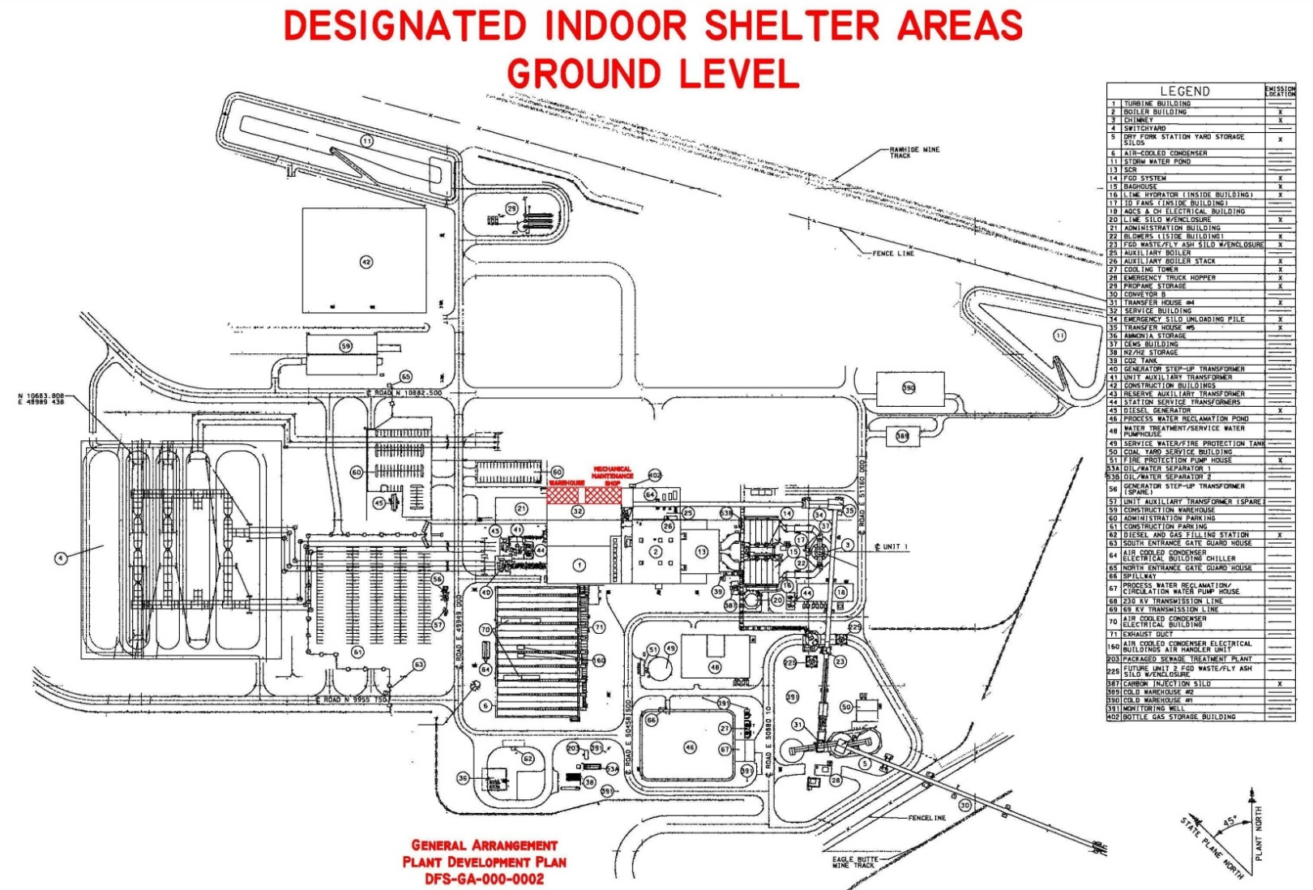
Indoor Evacuation
Inside Locations – 07:00-15:30
In Plant Warehouse
Product Delivery Drivers – Control Room

Slide 18
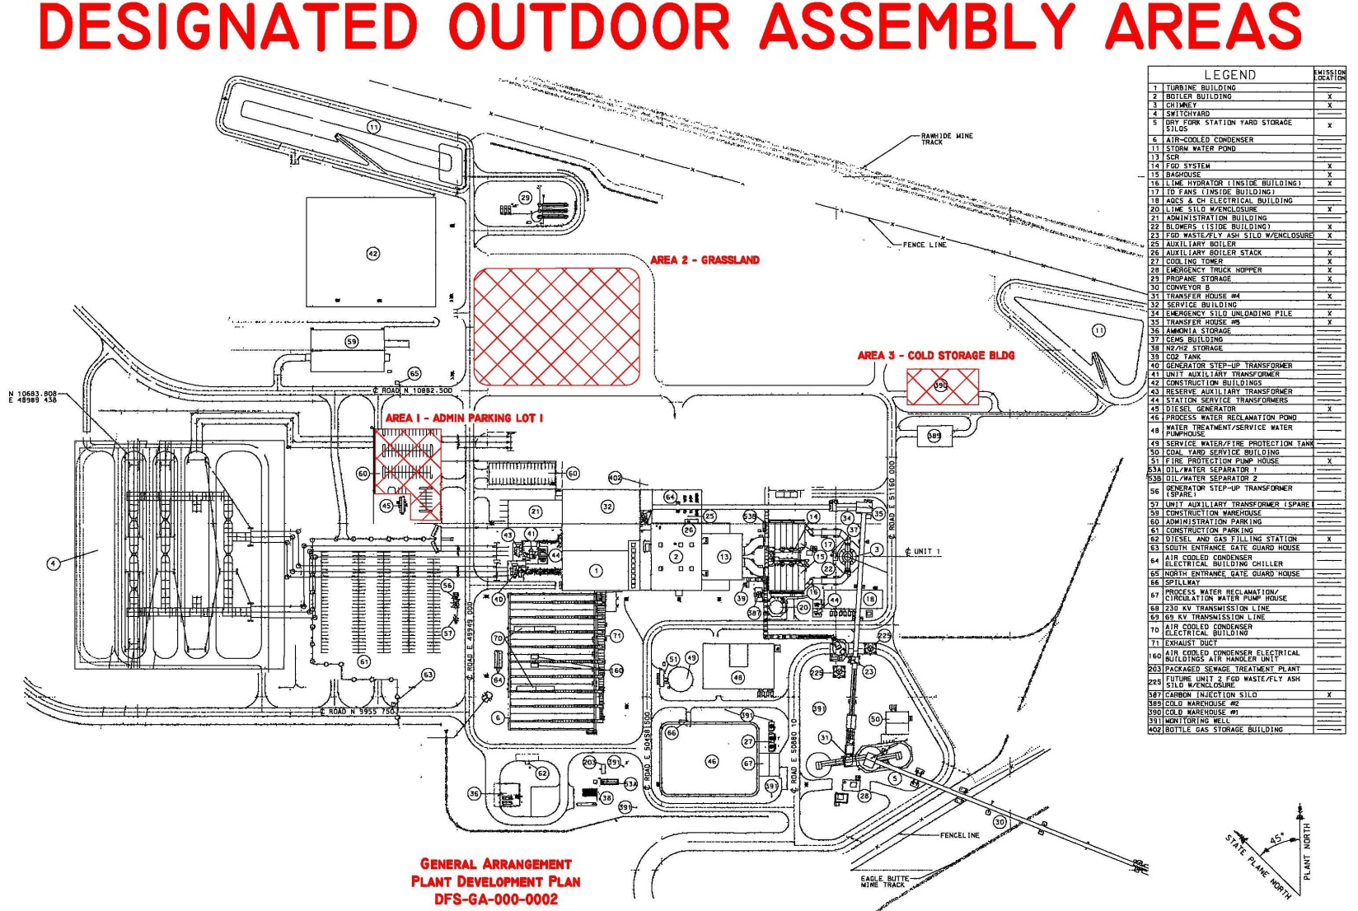
Outdoor Evacuation
Outdoor Locations
Upper Admin Parking Lot
Grassland
Warehouse 3 (Cold Storage)

Slide 19
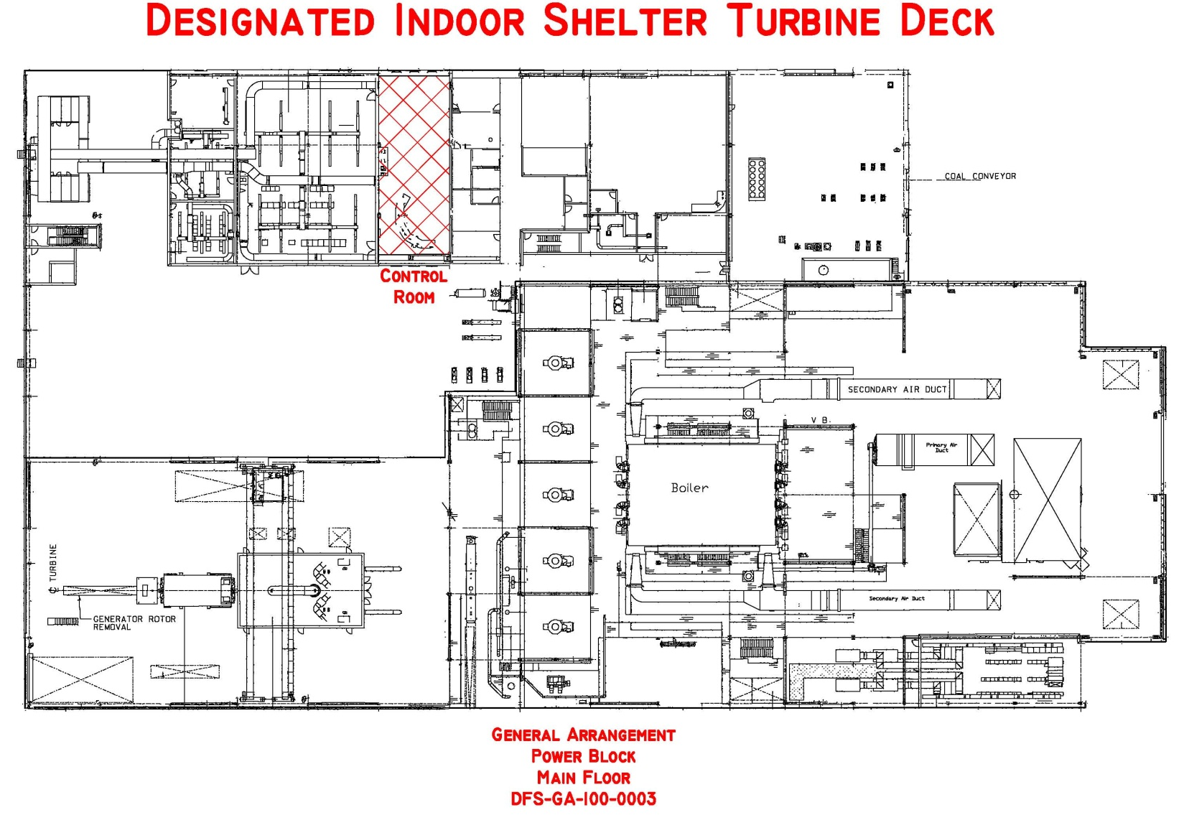
Off Shift Hours & Weekend Evacuations
Off-Shift Hours and Weekends
Control Room for all emergencies

Slide 20
Ammonia Release Evacuation
Inside Location – 07:00-15:30
Administration Building – Ground Floor, Meeting Room
Always move crosswind/upwind from the release.

Slide 21
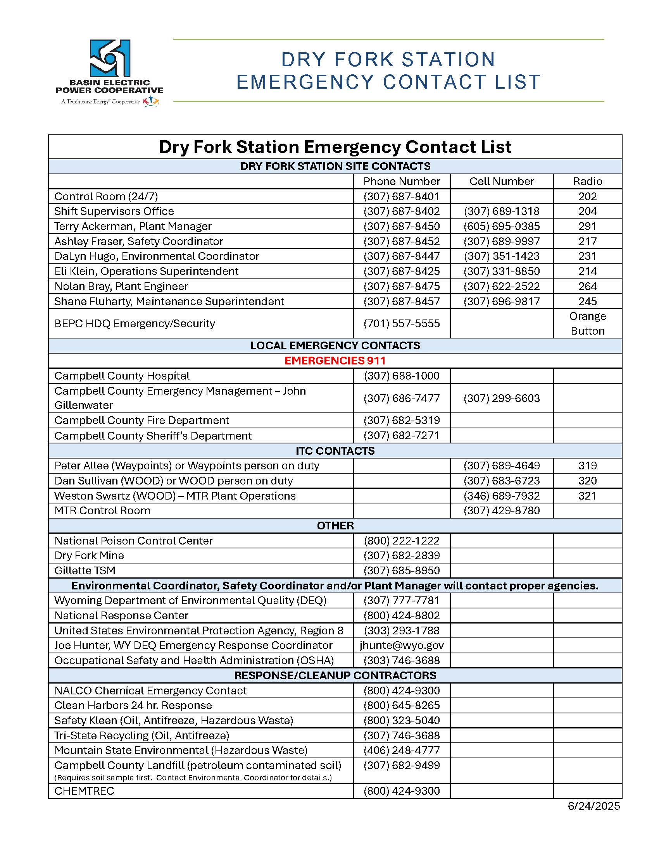

Slide 22
Incident Reporting
Near Miss
Property and/or Equipment Damage
Injury and/or Illness
Any other incident
Required to provide immediate notification to the Control Room, Supervisor, DFS On-Site Coordinator and/or DFS Safety Coordinator.
Contractors will be required to fill out an Incident Report and submit it to their DFS On-Site Coordinator.
Any communications after normal business hours must go through the DFS Shift Supervisor.
Falsification of any report or record is prohibited.

Slide 23
Fire Prevention & Protection
Eliminate the cause of fire.
Prevent loss of life .
Protect property from fire.
Flammable Material
Wood
Paper
Cardboard
Flammable gasses and liquids
Electrical components
Good housekeeping work practices are a vital part of safety.
Report all fires to the control room!
Flammable materials must be stored in flammable cabinets.

Slide 24
Incipient Fire Response
All fires will be immediately reported to the Control Room.
The Shift Supervisor (Incident Commander) will direct the response for fires. Use a fire extinguisher for fires in the initial stage or beginning stage and which can be controlled or extinguished by portable fire extinguishers and as long as you have been trained.

Slide 25
Electrical Fire Hazards
Make sure worn wires are replaced.
Use only approved extension cords.
Make sure equipment is properly grounded or double insulated.
Inspect all cords and tools prior to each use.
Dispose of waste daily.

Slide 26
Housekeeping
Minimize storage of combustibles.
Make sure all exits are free of obstruction.
Make sure eye wash stations, electrical panels and fire extinguishers are not blocked.
Store flammables away from ignition sources, preferably in flammable cabinets.
Report all detected gas leaks.
Do not overload circuits with multiple pieces of equipment.
Secure all gas cylinders.
Turn off equipment when not in use.
Clean up the work area everyday.
Put trash in appropriate garbage receptacles.

Slide 27
Personal Protective Equipment (PPE)

Slide 28
Standard PPE
Eye and Face
ANSI Z87.1 Safety Glasses with side shields
Face shields or goggles may be required per job requirements
Head
ANSI Z89.1 Hard hats
Welding shields for those welding
Feet
ANSI Z41.1 or ASTM F2412, 2413 footwear
Hearing Protection – Air pods, ear buds or similar devices are not allowed!
Gloves
Per Contractor company requirements for the hazards encountered on the job.
All other PPE requirements per contractor company policies.
Lime, particularly quicklime, is an alkaline material that is reactive in the presence of moisture. Workers handling lime must be trained and wear proper protective equipment.

Slide 29
FR/AR Clothing Requirements
Required for all Class A contractors.
Reporting to duty, contractors (Class A) will be wearing FR/AR Clothing with shirts tucked in, a leather belt or leather suspenders worn (if applicable), no more than one button open at the top, sleeves down and buttoned.
All other class of contractors must have long sleeves, pants and appropriate PPE for the job. Excessively torn/worn clothing is not acceptable.

Slide 30


Slide 31
Hazard Communication

Slide 32
Hazard Communication
Notify DFS On-Site Coordinator of any hazardous chemical being brought onsite.
Contact the DFS Safety or Environmental Coordinator and/or your On-Site Coordinator with Safety Data Sheet (SDS) or chemical questions.
Be able to provide a list of chemicals along with the SDS when asked.
Anything brought onsite by the Contractor must be removed by the Contractor.
All chemicals need a lid and a label!

Slide 33
Anhydrous Ammonia (NH₃)

Slide 34
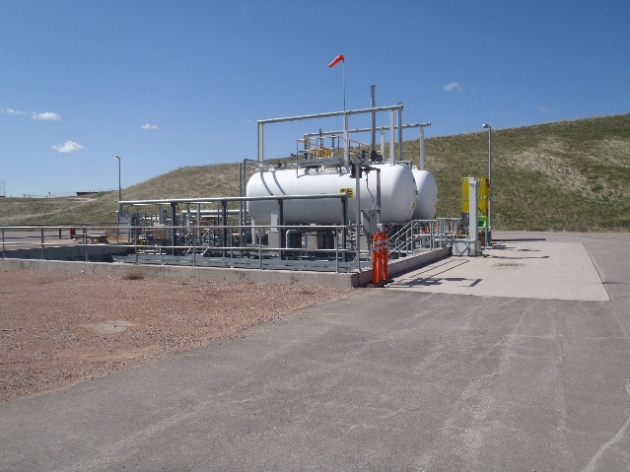
Anhydrous Ammonia (NH₃)
Anhydrous Ammonia
Colorless gas or compressed liquid with a pungent, suffocating odor.
Liquid ammonia reacts violently with water and vapor cloud is produced.
Avoid contact with vapor and liquid
Stay upwind and use water spray to absorb vapor.
Detectable at 5 ppm, if detected, notify the Control Room Immediately.
Evacuate upwind/crosswind.
If exposed:
Remove from exposure.
Flush with lots of water for at least 15 minutes.
Do not induce vomiting if ingested, give 1-2 glasses of milk or water.
Water, Water, Water!
Seek medical attention immediately.

Slide 35
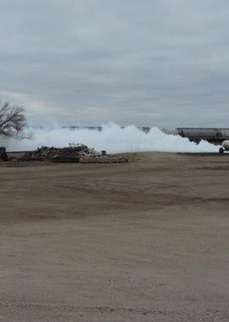
Anhydrous Ammonia (NH₃)
In the event of a gas or vapor release, DO NOT try to outrun the vapor or gas cloud by going down wind. ​
Avoid all contact with vapor cloud.​
Always move cross wind (90 degrees to the wind) from the leak. This is the quickest way to get away from a vapor cloud.​
Pay particular attention to the wind direction and the source of the leak. One of the assembly areas may be in the path of the vapor or gas cloud and cannot be considered an assembly area.​
If you are in another department/area, report to the nearest evacuation or shelter in place area and report to the person in charge of that area. ​

Slide 36
Anhydrous Ammonia (NH₃)
The word "anhydrous" means without water. When anhydrous ammonia comes in contact with any moisture, the water and ammonia quickly combine.
If ammonia contacts your eyes, skin or mucous membranes, it will cause rapid dehydration and severe burns as it combines with the moisture of the body.
Anhydrous ammonia is caustic and causes severe chemical burns. Body tissues that contain a high percentage of water, such as the eyes, skin, and respiratory tract are very easily burned.
Victims exposed to even small amounts of ammonia require immediate treatment with large quantities of water to minimize the damage.

Slide 37
Anhydrous Ammonia (NH₃)
The acute effects of ammonia are listed below:
5 ppm | Least perceptible odor
20-50 ppm | Readily detectable odor
35 ppm | Lights and Alarms go off at the tanks – increases as ppm increases
50 ppm | OSHA PEL-8hr work shift
50-100 ppm | No discomfort or impairment of health for prolonged exposure
150-200 ppm | General discomfort and eye tearing; no lasting effect on short exposure
400-700 ppm | Severe irritation of eyes, ears, nose, and throat; no lasting effect on short exposure
1700 ppm | Coughing, bronchial spasms
2000 -3000 ppm | Dangerous, less than one-half hour exposure may be fatal
5000-10,000 ppm | Rapidly fatal

Slide 38
Dropped Object Prevention Plan

Slide 39
Dropped Object Prevention
Provide employees with appropriate dropped object prevention training.
Correct any unsafe practices or conditions immediately.
Plan tasks and monitor work areas in a way that reduces the potential for workers to be exposed to hazards from falling objects.
Report any dropped or fallen objects to the DFS On-Site or Safety Coordinator.
Stop work if hazardous conditions prevent the job from being done safely.
Dropped object zones (DOZ) need to be clearly marked with red barricade tape.

Slide 40

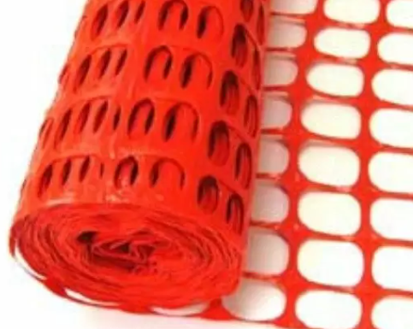
Dropped Object Prevention
Dropped object methods:
Tool Lanyards
Tool buckets with enclosures
Safety netting/fencing
Toe boards
Housekeeping
Covering holes and opening appropriately
Holes and openings in decks and platforms shall be managed. Fire blankets or other adequately constructed coverings shall be utilized over floor penetrations and other small openings to prevent dropping smaller objects. (i.e. nuts and bolts)
Special attention shall be given to cleaning up of smaller objects such as bolts, welding rod, etc. that could be dropped or kicked through smaller openings, and tin or plywood that could be blown off by wind gusts.

Slide 41
Scaffolding
Red barricade tape shall be installed when erecting, modifying and dismantling scaffold to ensure no foot traffic in the DOZ.
If work is to be performed from scaffolds over areas where employees must walk or work below, scaffolds shall have complete toe boards, netting and/or covered walkways installed. If not applicable document deficiencies on scaffold tag (i.e. toe board cannot be installed due to space constraints).

Slide 42
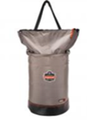
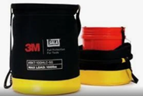
Lifting & Lowering Materials
The lifting or lowering of tools should only be done with a safe bucket or canvas bucket designed for lifting.
The lifting of plastic or metal buckets by the handle between floors is not permitted. These buckets may be placed inside a canvas or lifting bucket.

Slide 43
Tool & Material Storage
Where tools or materials are stacked higher than the edge of the toe boards, screening or paneling will be constructed from the working surface to the top of the guardrail or mid-rail. This will be done for a sufficient distance to ensure these objects will not have an opportunity to become drop hazards.
Using wire or s-hooks to secure objects to mid-rails to prevent objects from being tipped or kicked over elevated edges.
All stacked materials should be stable and self-supporting.
Blankets can be placed to prevent objects from falling through grating, buckets can be used to store small parts and tools, wire or straps can be used to secure larger materials and buckets.

Slide 44
Barricade Tape

Slide 45
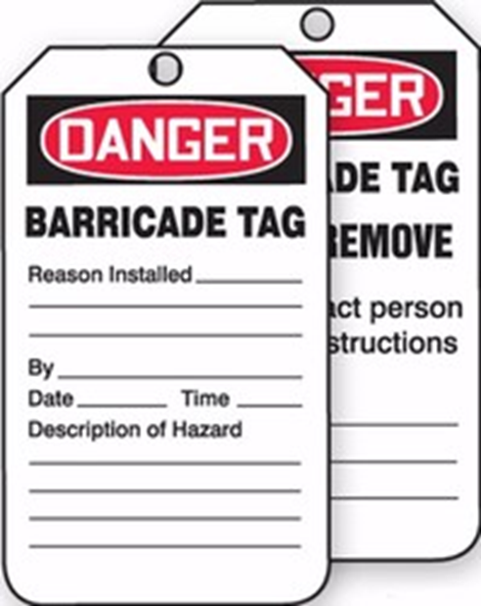

Red Barricade Tape
Red: DANGER DO NOT ENTER; is used to mark an area where a condition exists that is immediately dangerous to life or health.
Must completely surround the area.
Must have a red tag attached to each piece of tape installed.
Must be logged in the Red Barricade Tape and Do Not Operate Tag log in the Operating Authority’s office.
Must remove ALL tape installed when work is complete and sign off the log.

Slide 46
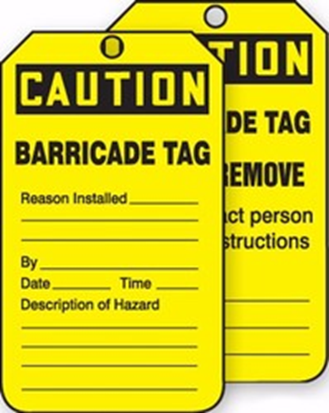

Yellow Barricade Tape
Yellow: CAUTION; is used to mark an area where a condition exists that is hazardous.
Must completely surround the area.
Must have a yellow tag attached to each piece of tape installed.
Must remove ALL tape installed when work is complete.

Slide 47
Barricade Tape
Authorization for entry into an area of another work group, barricaded with red barricade tape will come from the work group signed on the barricade tape log.
If there is a conflict with another craft or work crew, arrangements will be made to coordinate the work – a scheduled job could be stopped or rescheduled if more urgent work needed to be performed in the area.
Red and Yellow tape cannot be used to surround the same area.
Do not close off walkways and traffic areas unnecessarily.

Slide 48
Contractor Policies/Tools

Slide 49
Contractor’s Program
Fall Protection
4’ requirement
Confined Space entry
Respiratory/Fit Testing
Waste Ash and Lime Silos are respirator recommended, and dust masks are not allowed as respiratory protection.
Scaffolding
Shift inspections are required for all scaffold structures.
Do not access scaffold if it has not been inspected for that shift.
Follow all requirements listed on the scaffold tag.
Line Breaking and Penetration

Slide 50
Contractor Tools
GFCI protection is required on all extension cords and powered hand tools
Extension cords, welding leads, and air hoses must be kept out of walkways and doorways
Run overhead or under walkways
Small tools are the responsibility of the contractor to supply
All tools and equipment must be in good working order (guards, handles, and protective shields in place)
Only serviceable fiberglass ladders in compliant condition are allowed on site
All loads shall be rigged by a person qualified to rig loads.
Compressed gas cylinders must be stored properly. (In carts, tied off to a beam or structure.)
When transporting cylinders from a storage area use a proper cart and secure them to the cart. When not in use keep the cap on them.

Slide 51
Contractor Tools
Scaffolds shall be erected and kept in accordance with applicable standards, with toe boards, ladders, and decking properly installed. They must be inspected daily prior to use by a competent person.
Barricades must be used around excavation areas. Personnel protection (shoring, trench box, benching, or slope) will be strictly adhered to.
Keep work area as clean as possible, empty trash cans daily, and throw towels and rags in proper disposal cans. Do not litter inside or outside.
Basin personnel will check work area for safety hazards and to ensure the work area is clean when the job is done.

Slide 52
Belt Manlift

Slide 53

Belt Manlifts

Slide 54

Belt Manlift Usage
Only authorized trained personnel will be permitted to use the manlifts.
Unsafe conditions must be reported immediately and the manlift taken out of service.
No freight, pipe, lumber or materials of any kind will be carried or transported on the manlifts.
No tools shall be carried on the manlifts, except those that fit entirely in a pocket, tool pouch or holster.
Tripping the belt is a major issue during the outage, please ensure your authorized riders contact the Control Room if they trip the belt.

Slide 55

Training on Manlift
Everyone must watch the video and complete on the job training prior to being authorized to ride the belt manlift.
Practice and Demonstration
Start at the lowest step and review procedures.
Make sure everyone is clear
Wait for the handhold to appear at waist level
Step on the next step as it levels with the landing
Face the belt and grasp the handhold with both hands
Place both feet squarely on the step
Show employees how to reset the manlift.

Slide 56
Training on Manlift
Stop the manlift almost immediately by pulling the rope.
Explain operation of the start/stop control rope
Ride to the first landing and return to the trainees on the down belt
Explain the steps taken in dismounting
Answer any questions
Belt Manlift Certification Record SAF-6029 needs completed and turned into the On-Site Coordinator once on-site. OJT will occur at DFS.
There are pink hard hat stickers for Belt Manlift trained individuals that are required to be on the back of the hard hat. Riders must have this sticker, or you will be asked to take appropriate action if found riding without proper authorization.

Slide 57
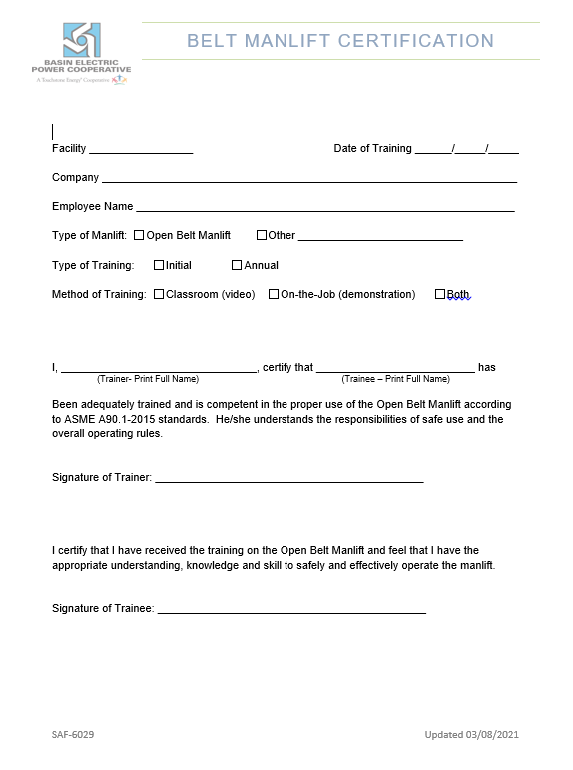

Slide 58
Mobile Equipment

Slide 59
Mobile Equipment
Use of any plant equipment must be approved by the On-Site Coordinator.
Prior to the use of any DFS mobile equipment individuals must obtain authorization from DFS, complete a Contractor Mobile Equipment Training Verification Form (SAF-6102).
Scissor or boom lifts
Overhead cranes
Once authorized, contractors are required to complete an equipment inspection prior to use on each piece of mobile equipment. Inspection books are in each piece of mobile equipment.
Contractors utilizing DFS equipment must notify the On-Site Coordinator of any deficiencies immediately for removal from service or corrective maintenance.

Slide 60
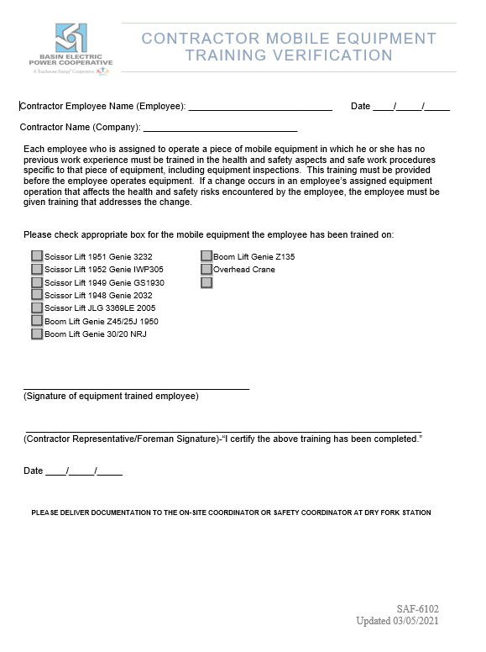

Slide 61

If you are not a Class A Contractor, skip to the Environmental Orientation. If you are a Class A Contractor please continue.

Slide 62
Clearances Lockout/Tagout

Slide 63
Definitions
Contractor Authorized Employee | A Contractor who requests a Clearance to perform servicing or maintenance on the machine or equipment or represents a Work Group.
Contractor Servicing Representative | Contractor employees responsible for servicing or maintenance at DFS that have been trained on OSHA 1910.147 by their company and are represented by their Contractor Authorized Employee(s) for Clearance Requirements.
Primary Clearance Holder | Is an Authorized Employee signed onto a Green Tag Clearance and is responsible for work being performed and the safety of the employees within their Work Group who are working under the protection of the Green Tag Clearance. Responsible for following the Clearance Program and representing the Work Group when signing on a Clearance. Only utilized for Green Tag Clearances.
Work Group | Is used when two or more Authorized Employees and/or Contractor Servicing Representatives are performing covered service or maintenance under a Clearance. The Primary Clearance Holder is the only individual who signs on the Green Tag Clearance for a Work Group. The Contractor Authorized Employee(s) is the only individual who signs on to a Red Tag Clearance for Contractor Work Groups. This is only used for a Green Tag Clearance or for Contractors.

Slide 64
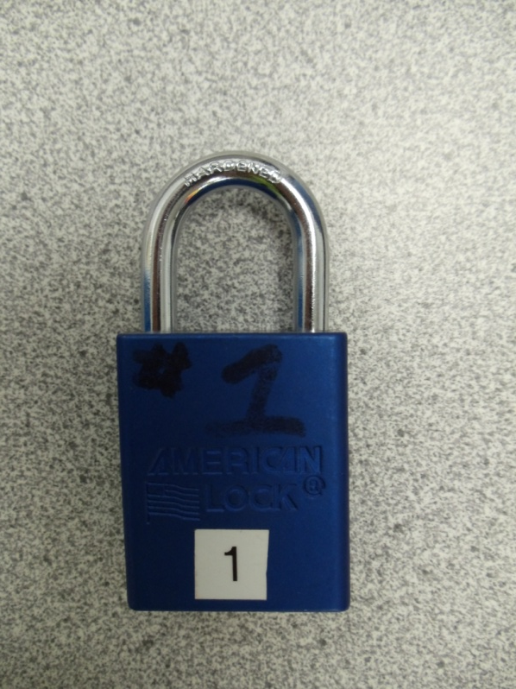
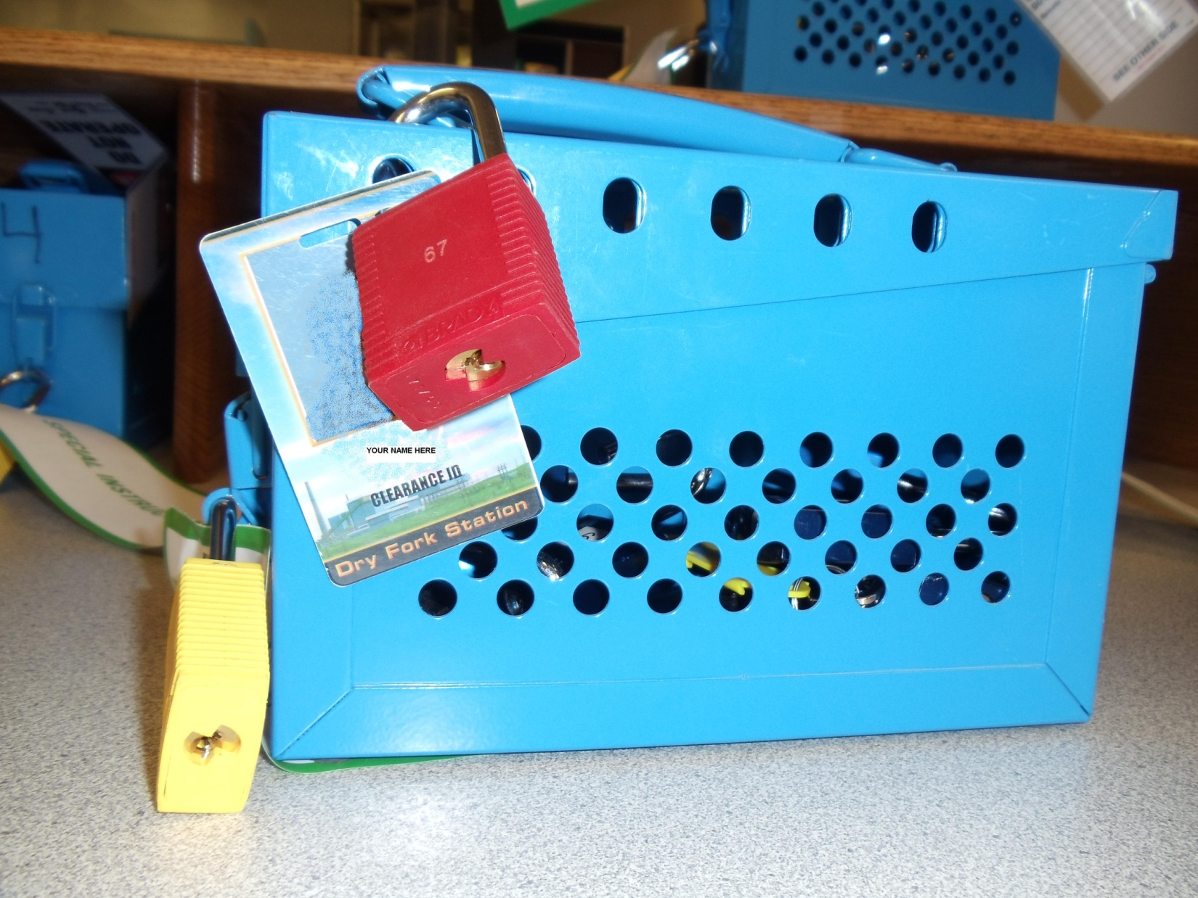

Clearance Locks
Blue Lock – on the energy source in the field.
Yellow Lock – Operating Authority lock to lock the lockbox.
Red Lock – personal lock to secure the lock box. Must be placed in conjunction with Clearance ID Badge.

Slide 65
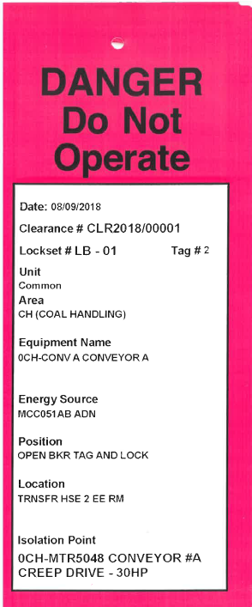
Contractor Work Groups
Each Work Group performing work on a piece of equipment or system must have a Qualified Employee (Group Representative) signed on the clearance.
Procedure:
Obtain an isolation list from the Operating Authority
Walk the Clearance Boundaries
Verify energy isolation and equipment
Initial tags
Return to the control room
Place Clearance ID Badge and personal/red lock on appropriate lock box
Sign on the clearance

Slide 66
NISOFT Sign On
Go to the Kiosk in the Control Room.
Login to NISOFT E3 with your login and password given by admin personnel.
Username: first initial, last name
Password: same (all lower case for both)
Select the clearance you want to sign on to.
Click the sign on button.
Enter your password and purpose for signing on that clearance.
Make sure your name is on the sign on sheet.
Log out of NISOFT.

Slide 67
Satellite Boxes
When the Contractor Authorized Employee has a Work Group working under their Clearance the Contractor Authorized Employee will place a red lock on the master lock box and remove the red lock key.
The red lock key will be placed into the satellite box and locked by Contractor Servicing Representatives personal locks that are working under the Contractor Authorized Employee’s Clearance.
Satellite boxes and personal locks will be provided and maintained by the Contractor.

Slide 68
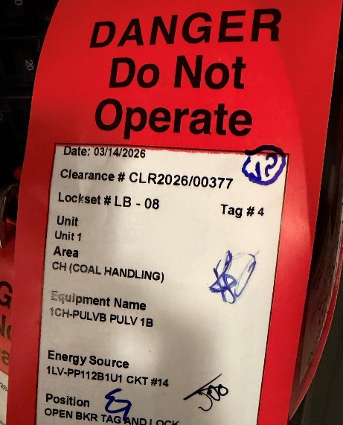
Electrical Verification
Any electrical cabinet (with exposed conductors) and non-visible disconnects 48V and above will require an E&I Tech to be present when the Clearance is placed and verified. This applies when any cabinet must be opened to hang and verify a lock/tag.
Once a live dead live test has proven the equipment is safe to work on, E&I Techs will legibly initial the tag with blue ink/marker in the upper right-hand corner of the white section of the Clearance tag, circle it and document the placement and verification of the electrical isolation points within the electronic Clearance system.
No unauthorized employee is allowed to open or enter cabinets above 48V. Authorized Employees are designated by the DFS Energy Verification and Control Program.

Slide 69
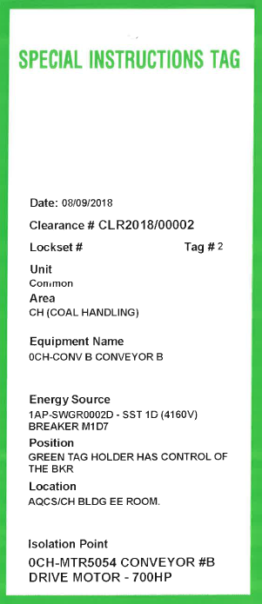
Green Tag Clearance
If used within a confined space, the confined space must be permit required.
Green Tag Clearances are only assigned to the Primary Clearance Holder and for a specific piece of equipment or system. The Primary Clearance Holder may have a Work Group working under his/her protection.
The Primary Clearance Holder is the ONLY authorized person to control the energy source.

Slide 70

Primary Clearance Holder
Request a Green Tag Clearance from the Operating Authority.
Obtain an isolation list and a Green Tag Clearance Lock Box.
Sign on the Green Tag Clearance.
Isolate equipment in accordance with the work being performed and at the discretion of the Primary Clearance Holder.
Place Clearance ID badge, Green Clearance Tag and green lock on each isolation point.
Verify isolation per the DFS Energy Verification and Control Program, this may require a DFS E&I Tech.
Lock the key in the Green Tag Clearance lock box and secure the box with a red lock and Clearance ID badge.

Slide 71
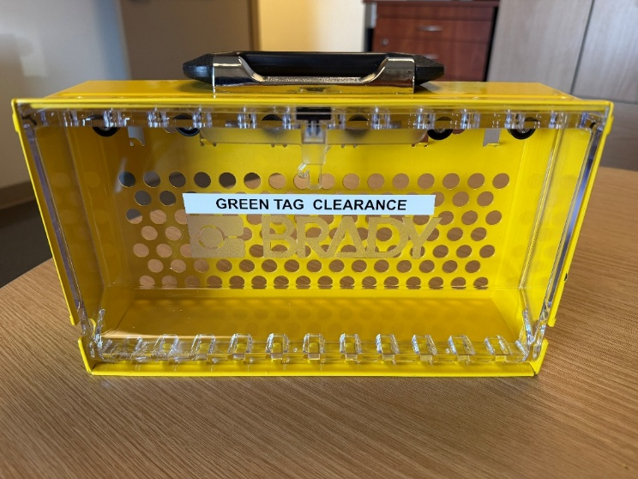
Primary Clearance Holder
Ensure that everyone in the Work Group working under the Primary Clearance Holder
Verifies isolation,
Initials the tags
All Contractor Servicing Representatives place a personal lock on the Green Tag Clearance lock box.
Once work is complete, the Primary Clearance Holder shall ensure everyone in the Work Group is clear of equipment and has removed their red/personal locks from the lock box.

Slide 72
Primary Clearance Holder
Remove locks and tags from equipment.
Return equipment to the restoration position and if this is not applicable, request a Red Tag Clearance or transfer the Green Tag Clearance over to another Primary Clearance Holder.
Return the Green Tag Clearance lock box (with locks) and tags to the Operating Authority.
Sign off the Green Tag Clearance.

Slide 73
Releasing Protection
EVERYONE MUST BE SIGNED OFF THE CLEARANCE!
Ensure everyone signed on within your company has signed off the clearance by the end of the job and prior to leaving site for the last time.

Slide 74
Off-Duty Release Form
If an absent Qualified Employee is preventing the conducting of a RELEASE only the individual’s immediate Supervisor can authorize releasing that employee from the clearance.
The individual’s immediate Supervisor will personally contact him/her before releasing the Clearance. If the individual cannot be contacted before releasing the Clearance, the Supervisor must notify that individual as soon as he/she can be contacted. The employee must be notified at the beginning of their next scheduled workday.
An Off-Duty Clearance Release Form will be completed.
Notes:
If your work is complete and you fail to sign off the clearance at the end of your shift and need to be called out to release the clearance you may not be compensated for that time. This will be considered a Clearance violation and may be subject to disciplinary action.

Slide 75
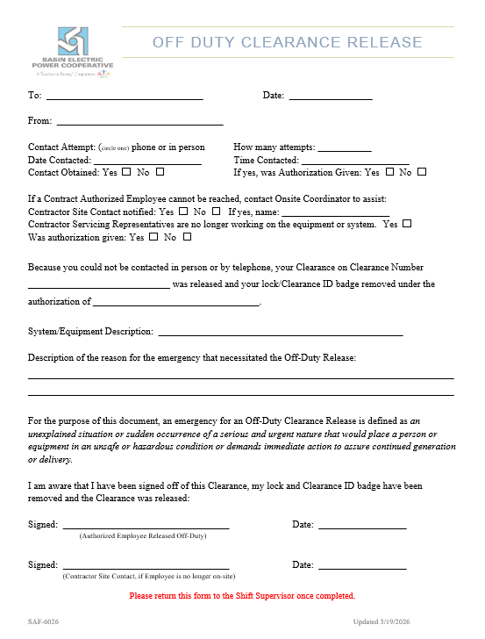
Absent Employees
An Off-Duty Release Form must be initiated and submitted to the individual’s immediate Supervisor for notification to the Authorized Employee at the beginning of their next schedule shift.

Slide 76
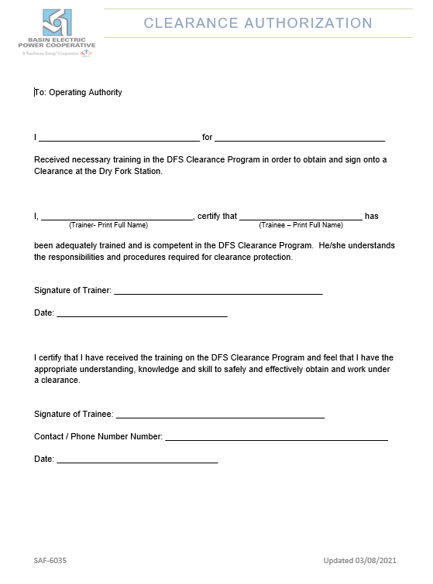

Slide 77
Energy Verification & Control

Slide 78
Responsible for:
Ensuring their safety and the safety of all individuals working with or around the energy source(s).
Being knowledgeable in the equipment being worked on and the associated system.
Following DFS Clearance and Energy Verification and Control procedures.
Commencing work safely.
Working with and walking down Clearances with your DFS On-Site Coordinator or Operator until comfortable.

Slide 79
Guidelines
ALL machines and equipment should be acknowledged as hazardous until otherwise demonstrated!
Systems normally under pressure must be treated as if hazardous energy were present unless otherwise demonstrated.
Must verify that isolation and deenergization of the machine or equipment has been accomplished.

Slide 80
Potential Energy
Pneumatic/Hydraulic
Drains and vents may be used for energy verification when applicable and the Qualified Employee determines the appropriate position per the scope of work.
Pressure gauges may be used as well.
Thermal
Verification is done with an appropriate thermometer or temperature sensing device.
Chemical/Radiant
Employees that could be exposed to these energies must be properly trained before engaging in such work.
When working with chemicals, employees must don the correct PPE per the SDS.
Mechanical
Electrical

Slide 81
Mechanical Energy
Objects subject to falling need to be secured in a manner that prevents the object from shifting unexpectedly. This can be accomplished by:
Lifting the items in approved slings according to properly developed procedures.
Blocking raised items with blocks or cribbing designed to account for the weight of the object.
Transitional motion must be secured to prevent unexpected movement.
Rotational Motion must be accounted for and discussed as part of the JSA. Mitigation shall be determined by the individuals on the job.

Slide 82
Electrical Energy
High Voltage 15KV & Higher
Medium Voltage 4,160 & 13.8KV
480V Load Centers
Molded Case Circuit Breakers 480V and below

Slide 83
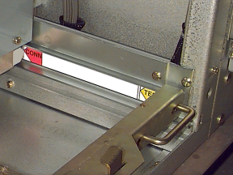
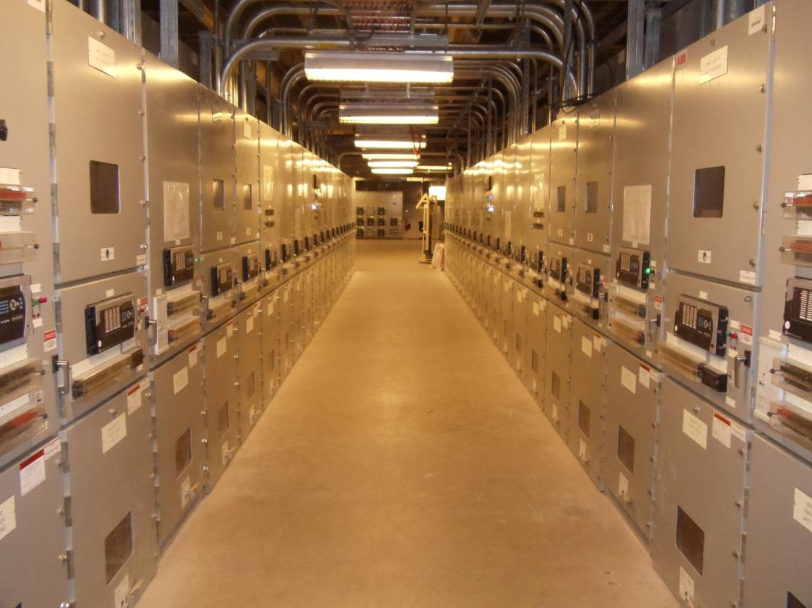
ABB SafeGear® 13.8kV & 4160V
Visible indicator can be seen when racking into the connected or test position.

Slide 84
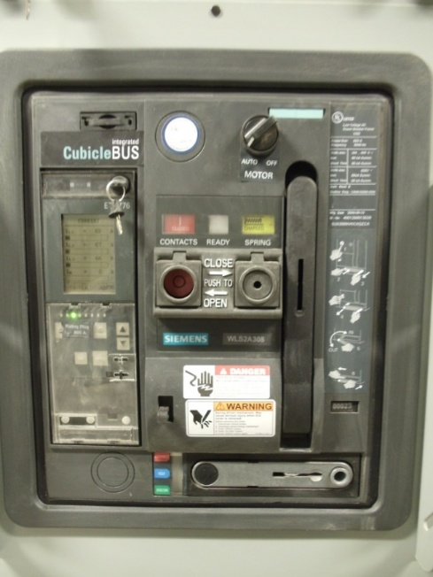
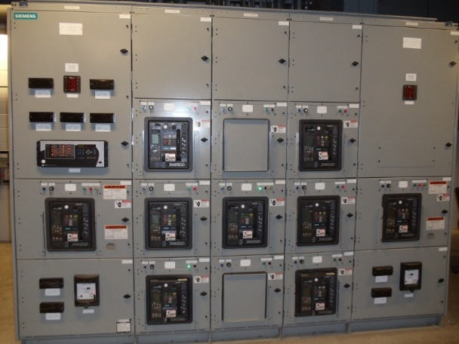
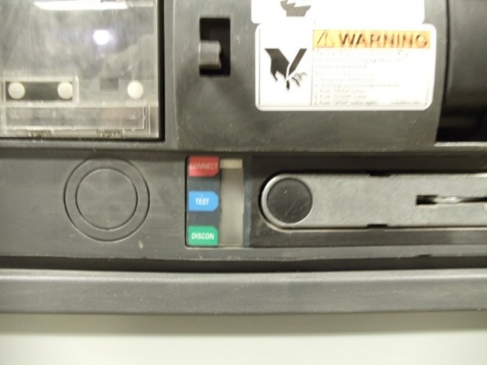
Siemens WL 480V
Mains 3200A
Feeder Breakers 800A

Slide 85
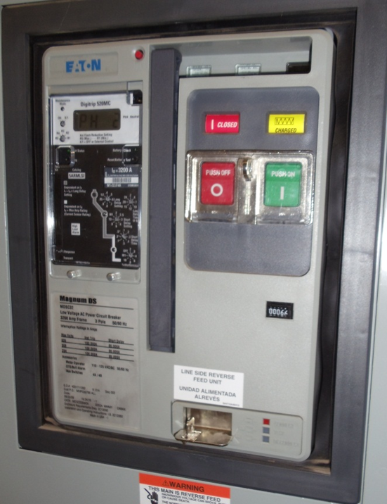
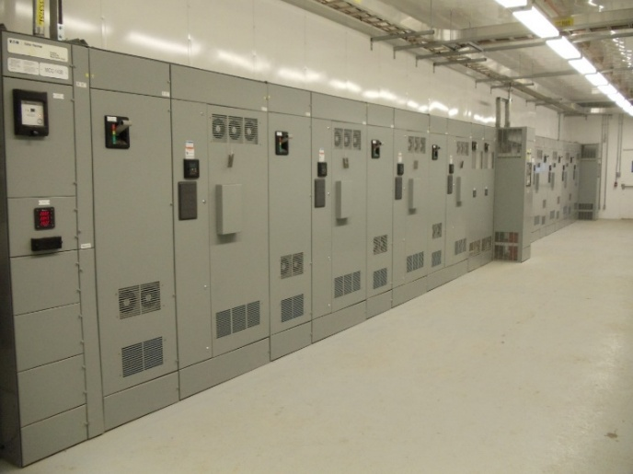
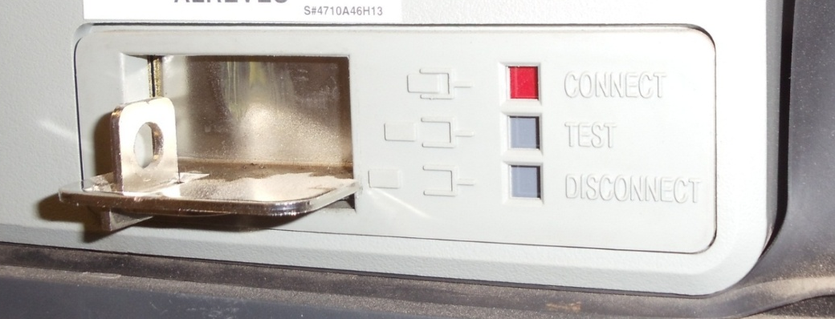
Eaton Magnum DS 480V
Mains 3200A
Feeder Breakers 800A

Slide 86
Electrical Cabinets & Non-Visible Disconnects (48V and above)
Any electrical cabinet (with exposed conductors) and non-visible disconnects 48V and above will require a DFS E&I Tech to be present when the Clearance is placed and verified. This applies when any cabinet has to be opened to hang and verify a lock/tag.
Once a live dead live test has proven the equipment is safe to work on, DFS E&I Techs will legibly initial the tag with blue ink/marker in the upper right-hand corner of the white section of the Clearance tag, circle it and document the placement and verification of the electrical isolation points within the electronic Clearance system.
ONLY DFS E&I Techs are allowed to open or enter cabinets above 48V for verification.

Slide 87
Electrical Equipment with Visible Disconnects
Whenever possible, visually verify that all blades of the disconnecting device are fully open or draw out type circuit breakers are withdrawn to the fully disconnected position.
Verify that there are no visible signs of damage.
When the physical opening of the contacts cannot be visibly verified the individuals need to contact the Operating Authority and/or On-Site Coordinator for further instruction.

Slide 88
Confined Space Entry

Slide 89
Contractors Responsibility
Training contract employees per OSHA 1910.146 and the DFS Confined Space Program.
Ensure a Contractor Authorized Employee is signed on the appropriate Clearance and following the DFS Clearance requirements.
Coordinating all confined space entries with the On-Site Coordinator and Operating Authority.
Providing (unless otherwise specified in the contract):
An Attendant for permit required confined spaces.
Personal Protective Equipment
Communication Equipment
Rescue for employees

Slide 90
Contractors Responsibility
Must obtain a confined space permit for all classifications of entry.
Permits must be properly completed, including Entry Supervisors authorizing entry.
At the conclusion of entry operations, a lead person/foreman or the Entry Supervisor will meet with the On-Site Coordinator and debrief on the entry.
If multiple work groups are working in the same confined space, a pre-job meeting shall be held with all Entry Teams to discuss the classification of the space prior to entry.
Keeping track of ALL Confined Space Permits!

Slide 91
Permit Duration
Permit Required Space
One-shift or 12 hours (whichever is first).
New permit issued at end of duration.
Declassified Space
Permit can be for duration of work.
Must keep track of all sign in sheets!!

Slide 92
Before Entry
Area is clear of all hazards (internal/external).
Hot Work Permit is obtained (if applicable).
Rescue Plan has been developed and attached or Contracted Rescue Team has been notified of entry.
Attendant is posted and will remain on duty until authorized entrants have exited the space.
All Authorized Entrants are wearing a full body harness.
Contract Group Representative has completed all Clearance requirements.
Permit has been obtained from the Operating Authority.

Slide 93
Atmospheric Checks
Atmospheric checks have been completed, recorded and meet OSHA criteria prior to entry.
Permit Required
Continuously monitored.
Documented prior to shift & every 3 hours thereafter. hours thereafter at a minimum.
Declassified
Documented prior to entry and once a shift.
Provided the job being performed does not create a prohibited condition.
Welding in a Confined Space
Checks taken every hour and documented on the Hot Work Permit.
Authorized Entrants and/or Entry Supervisors may perform and/or observe all atmospheric tests.

Slide 94
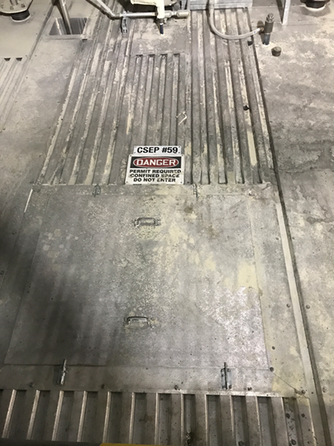
Entry Points/Spaces
Entry points are identified a CSEP#, this is where the attendant will be stationed, rescue equipment (when applicable) and the permit. Individuals will sign in and out of the space at this point.
Spaces are determined by boundaries. If you must climb out to get into another space, it is a new confined space.
Example: Boiler has 17 confined spaces.

Slide 95
Authorized Entry
Once Permit is filled out properly and signed by the Entry Supervisor and attendant, entry is authorized.
Authorized Entrants will sign in and out each time the space is entered and exited. (all classifications of space)
Each time the permit space is completely vacated; an Attendant will secure the permit, and no entry is allowed until an Attendant has returned.

Slide 96
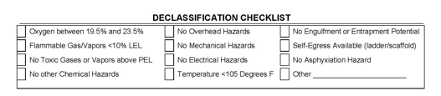
Declassified Space
Follow the declassification checklist on the permit.
Must be authorized by the Entry Supervisor.
Permit Duration will be determined by the Entry Team and documented on the permit under the declassification section.

Slide 97
Completion of Work or End of Permit Duration
Before turning in a permit, make sure everyone is signed out of the confined space.
All Authorized Entrants need to be signed out of the space.
The Attendant (when applicable) and the Entry Supervisor will ensure that all Authorized Entrants have exited the space, signed the permit and then sign the permit to close it out.
Entry Supervisor will return the permit to the Operating Authority.

Slide 98
Rescue
If there is not a contracted rescue team scheduled, then the contractor is responsible for rescue of their employees. A rescue plan must be submitted to the DFS On-Site and Safety Coordinator for approval.
The contract employees need to know what the rescue plan entails and how to execute it in an emergency.
There shall be a site rescue plan available at the confined space entry point or with the contracted rescue team (when applicable).
If a rescue is needed, employees must contact the Control Room. (Channel 1, radio/Gai Tronics)

Slide 99
Additional Information
Additional gas test sheets can be obtained from the Operating Authority.
Additional sign in sheets shall be obtained from the Operating Authority.
If borrowing DFS air monitors, please turn them in so they can be charged and bump tested for the next shift. Follow the Portable Gas Monitor Program.
If using your company’s air monitors, there must be a sensor that detects ammonia. (confined space only)

Slide 100
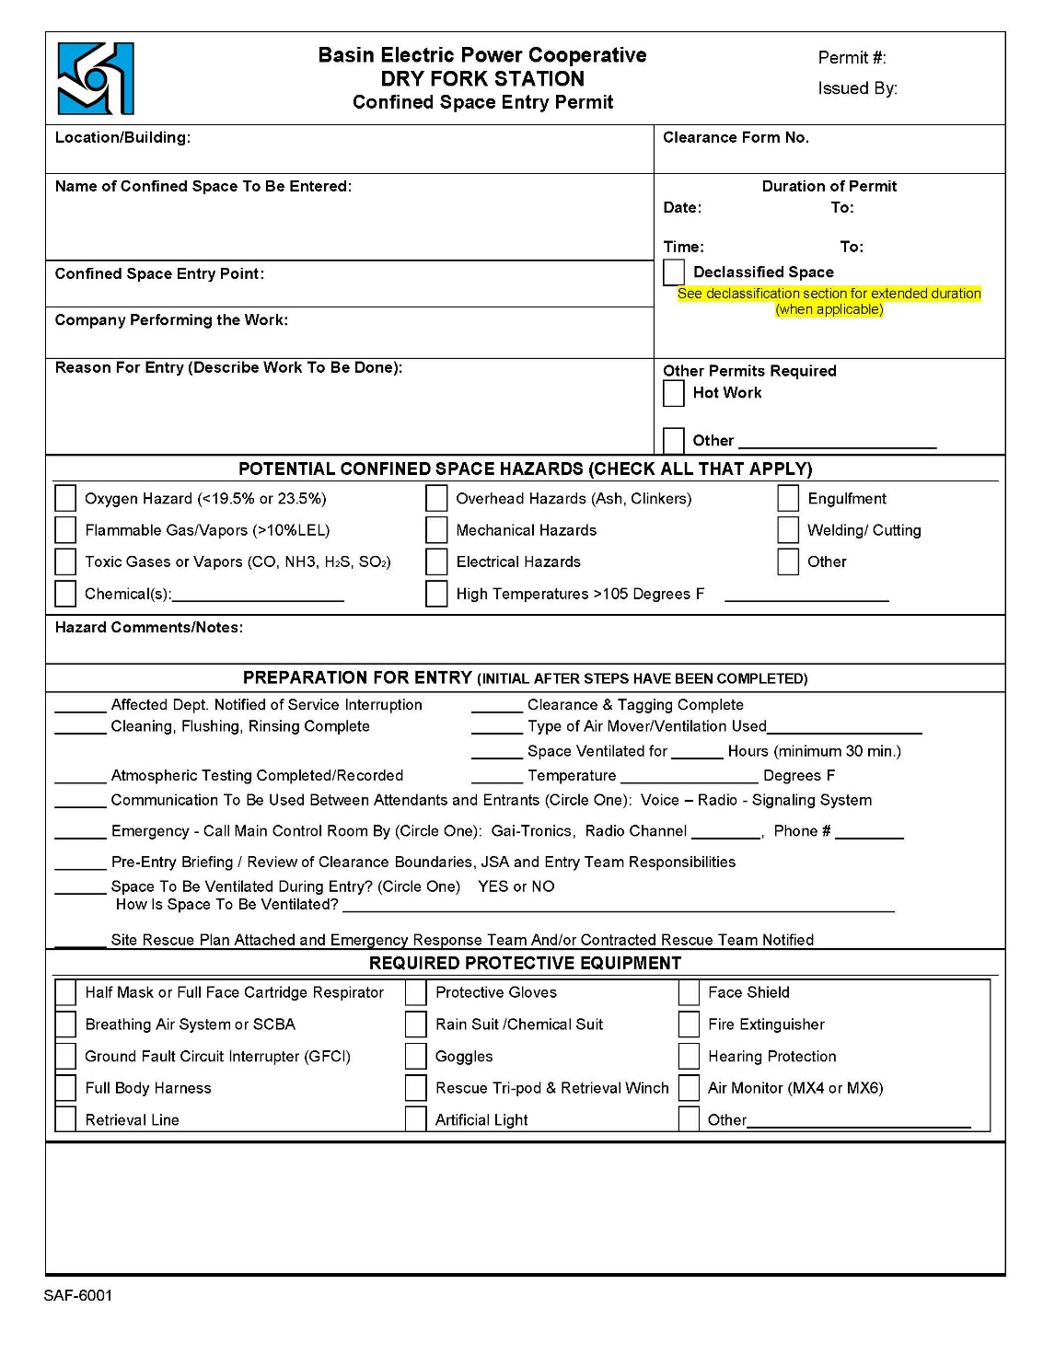
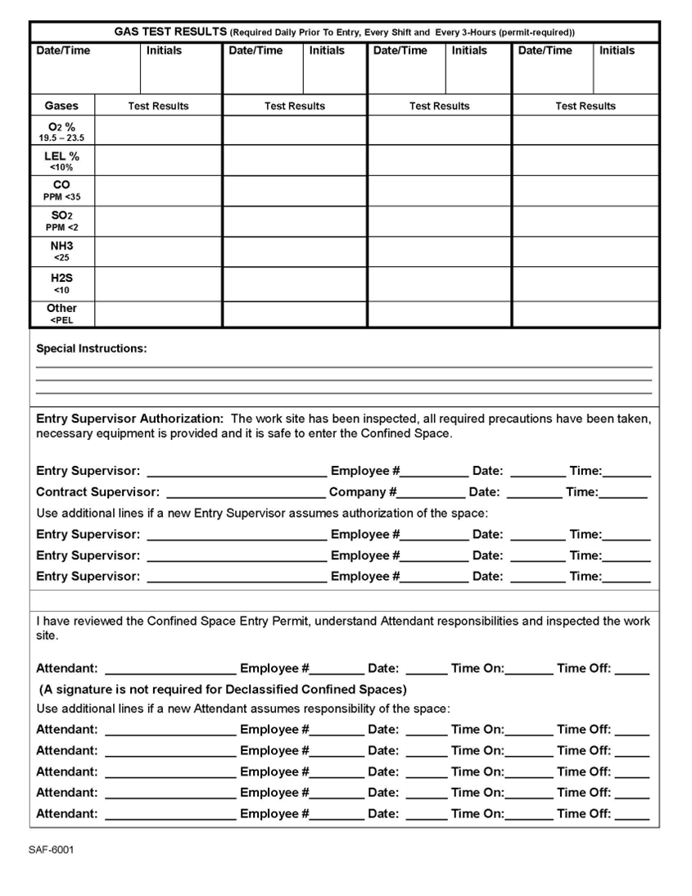

Slide 101
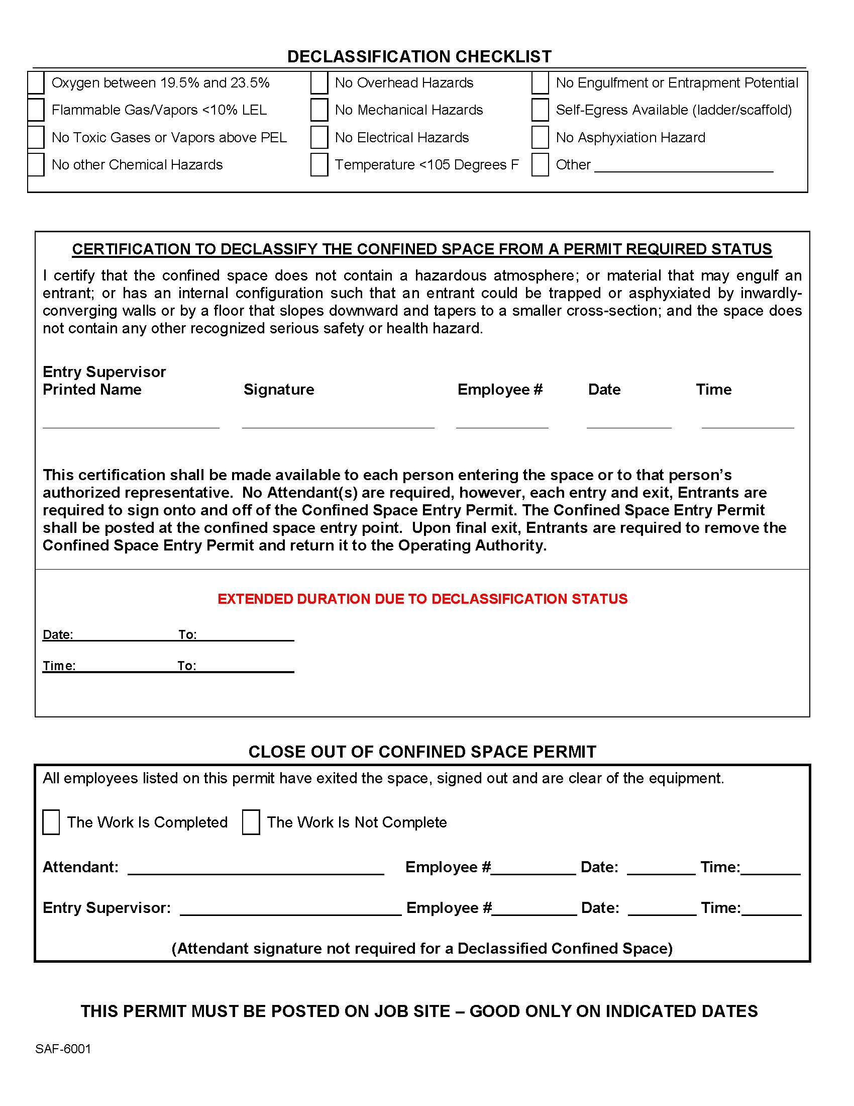

Slide 102
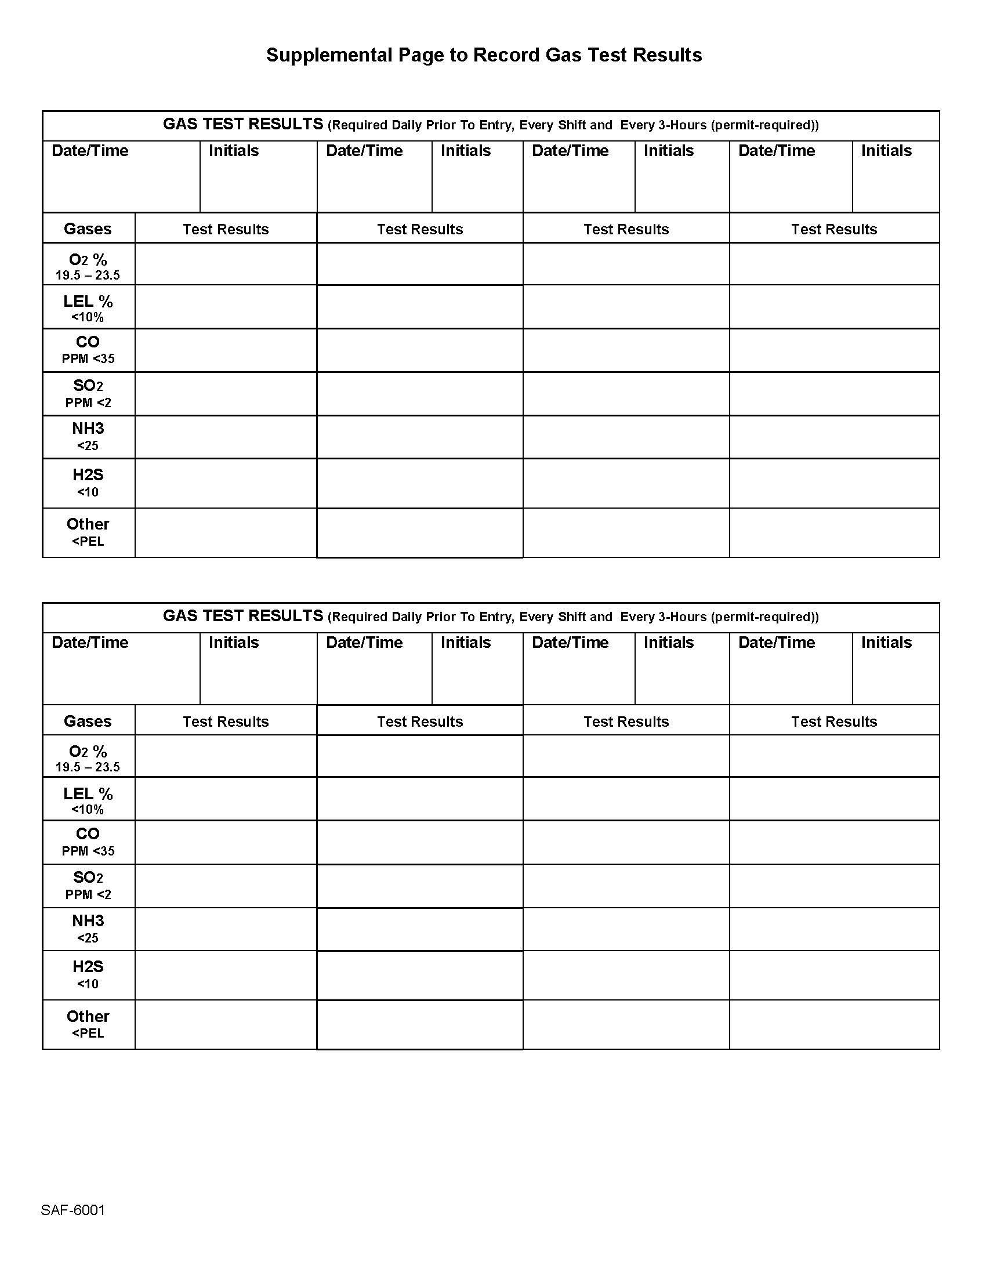

Slide 103
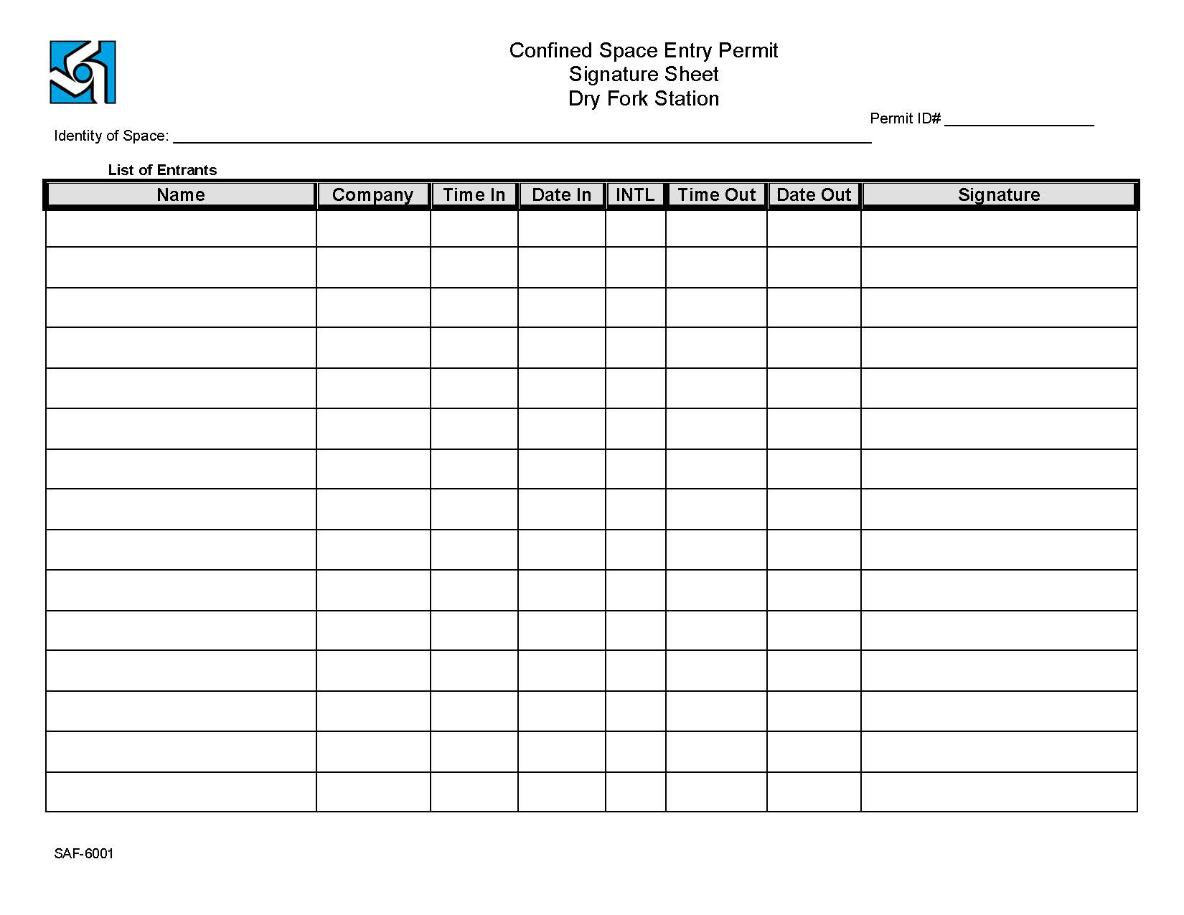

Slide 104
Hot Work

Slide 105
Definitions
Fire Watch: a Qualified Employee who observes Hot Work activities for the purpose of preventing, detecting and suppressing fires.
Hot Work Permit: written authorization to perform operations capable of providing and ignition source.
Lower Explosive Limit (LEL): the lowest concentration of flammable gas or vapor in air that can ignite and produce a fire or explosion when exposed to an ignition source. BEPC requires LEL to be ≤ 3%

Slide 106
Power Tools
Power Tool: a tool that is actuated by an additional power source and mechanism other than the solely manual labor used with hand tools.
Tool Examples
Acetylene Torches
Arc Welding
Portable Grinders
Propane Torches
Powder Actuated Guns
Impacts
Power Tools (cord or cordless)
Non-Rated Electrical Tools/Equipment
Hot Work Permits are required for power tools on Classified Systems.

Slide 107
Classified Systems
Classified System: an area or system that has been determined to have a general nature (or properties) of a hazardous material in the surrounding atmosphere.
Activated Carbon | Ammonia System | Coal System
Diesel Generator | Diesel/Fuel Tanks & System | Fire Diesel Pump House
Hydrogen System | Propane System | Sewage Treatment
Turbine Lube Oil | Any Class I Div II, Class II Div I, or Class II Div II Area

Slide 108
Fire Watch
Ensuring that safe conditions are maintained during hot work operations.
Signing on the Hot Work Permit.
Stopping hot work activities if an unsafe condition develops.
Notifying Control Room if a fire is detected.
Attempt to extinguish the fire with an appropriate fire extinguisher.
Remain in the area during lunches and breaks.
Remain in the area 30 minutes after work is complete or end of permit duration.

Slide 109
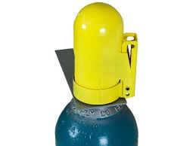
Qualified Employee
Establish permit duration.
Ensuring all elements of the permit are filled out properly.
Conduct hot work within the parameters of the permit
Ensure gas cylinders are secured.
Ensure that sparks and molten slag are confined to the work area and prevented from falling to other floors.
Stop hot work activities if any new hazards are introduced.
Ensure tools and equipment are in satisfactory condition and good repair.
Ensure that proper PPE is worn.
Ensure the Fire Watch remains in the area.

Slide 110
Procedure
Initiate Hot Work activities with the DFS On-Site Coordinator.
Obtain a permit from the Operating Authority.
Designate a person as Fire Watch.
Ensure precautionary measures have been completed.
Conduct atmospheric monitoring prior to creating the first arc, spark, or ignition source, including outdoors. Results must be within the atmospheric monitoring requirements and documented on the Hot Work Permit.
Contract Supervisor and Qualified Employee will review the work area and ensure the permit has been properly completed before signing the permit.
Everyone signs the permit.

Slide 111
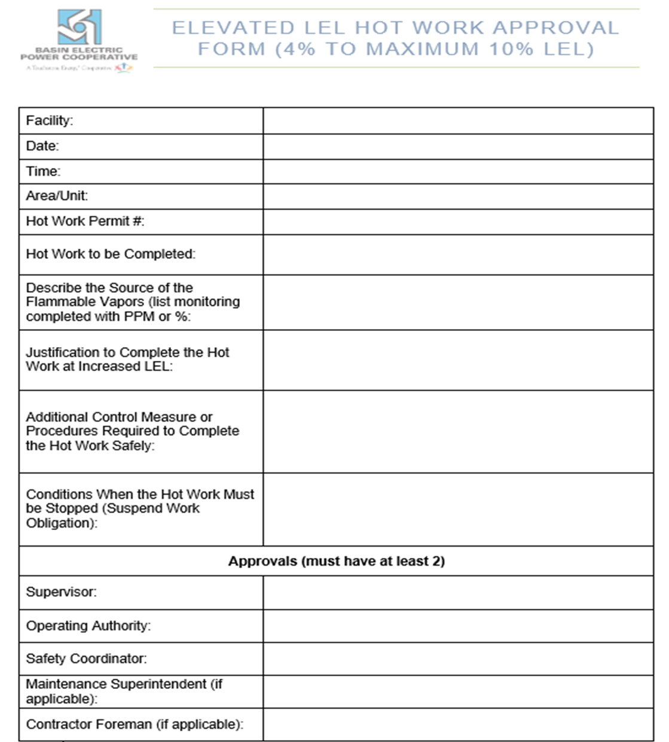
Elevated LEL Approval Form
Hot Work may not be performed ≥ 3% LEL.
Note: Elevated Hot Work Form must be completed prior to allowing Hot Work 4% LEL up to 10% (OSHA). The form must obtain two approval signatures and reside with the Hot Work Permit in the field.

Slide 112
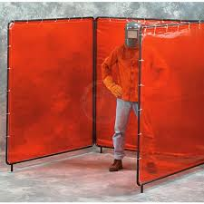
Hot Work Requirements
Atmospheric monitoring must be conducted and recorded every hour on the Hot Work permit if welding in a confined space, continuous monitoring is recommended.
Permits are good for 12 hours or one shift.
Hot Work must be adequately screened/protected to protect nearby workers or passers-by from the glare of welding and sparks/slag from falling to floors below or entering wall or roof openings or other such areas.
Keep track of permits and have at the hot work location.
End of shift, complete the ½ hour fire watch and return to the Control Room. If it is not returned, you are responsible for the 3-hour final checkup.

Slide 113
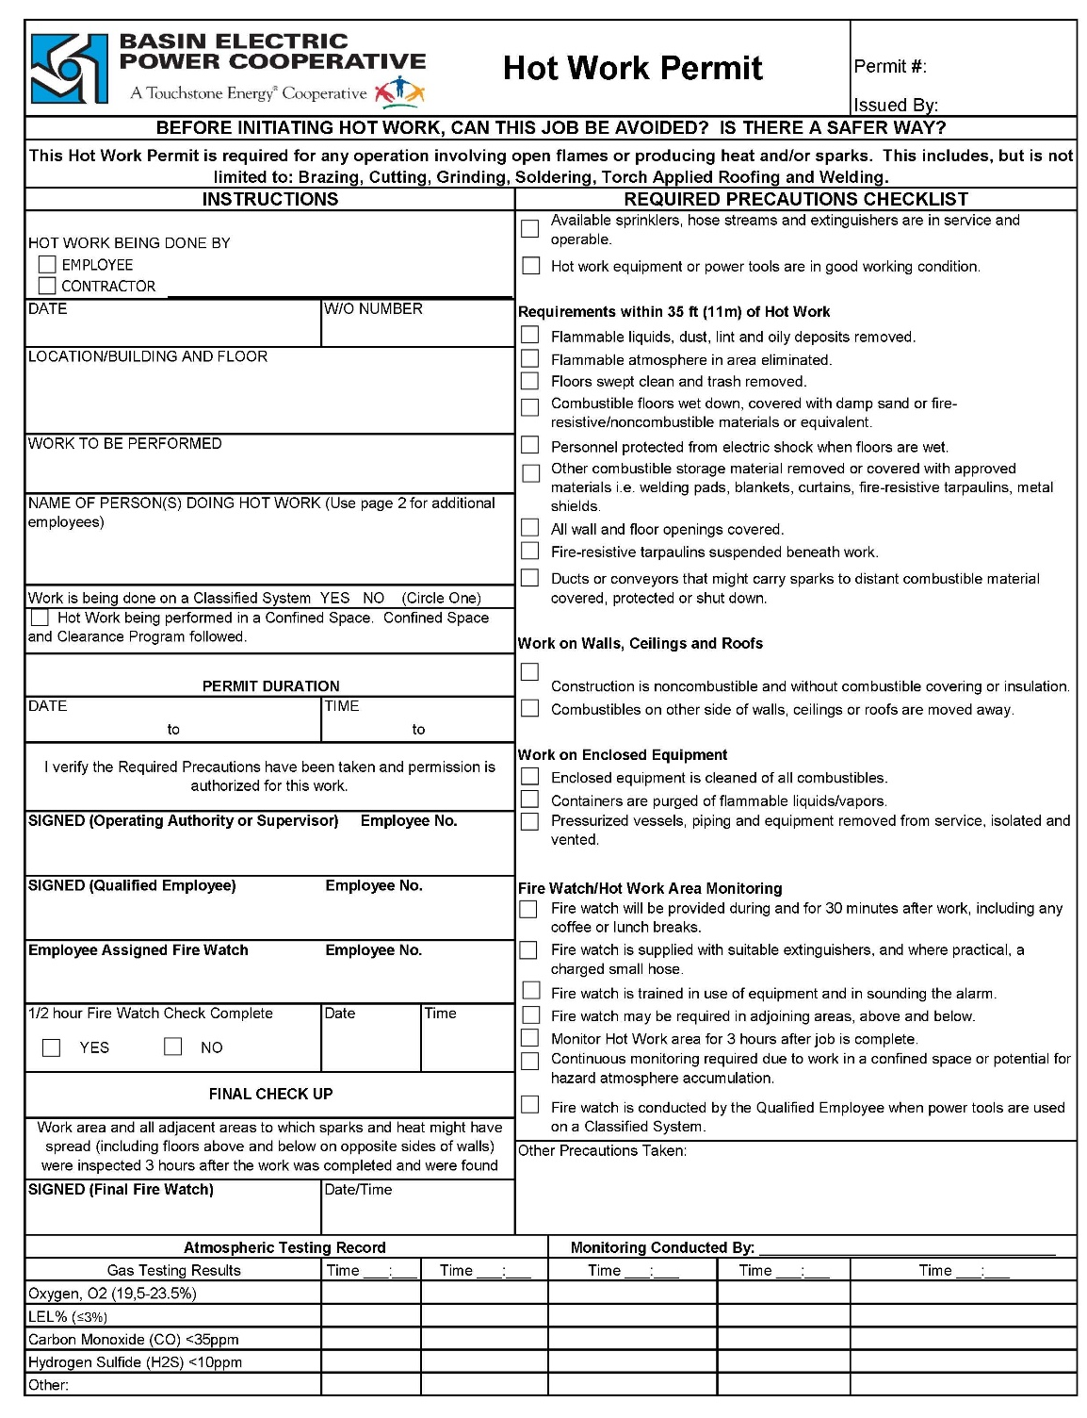
UPDATED PERMIT

Slide 114
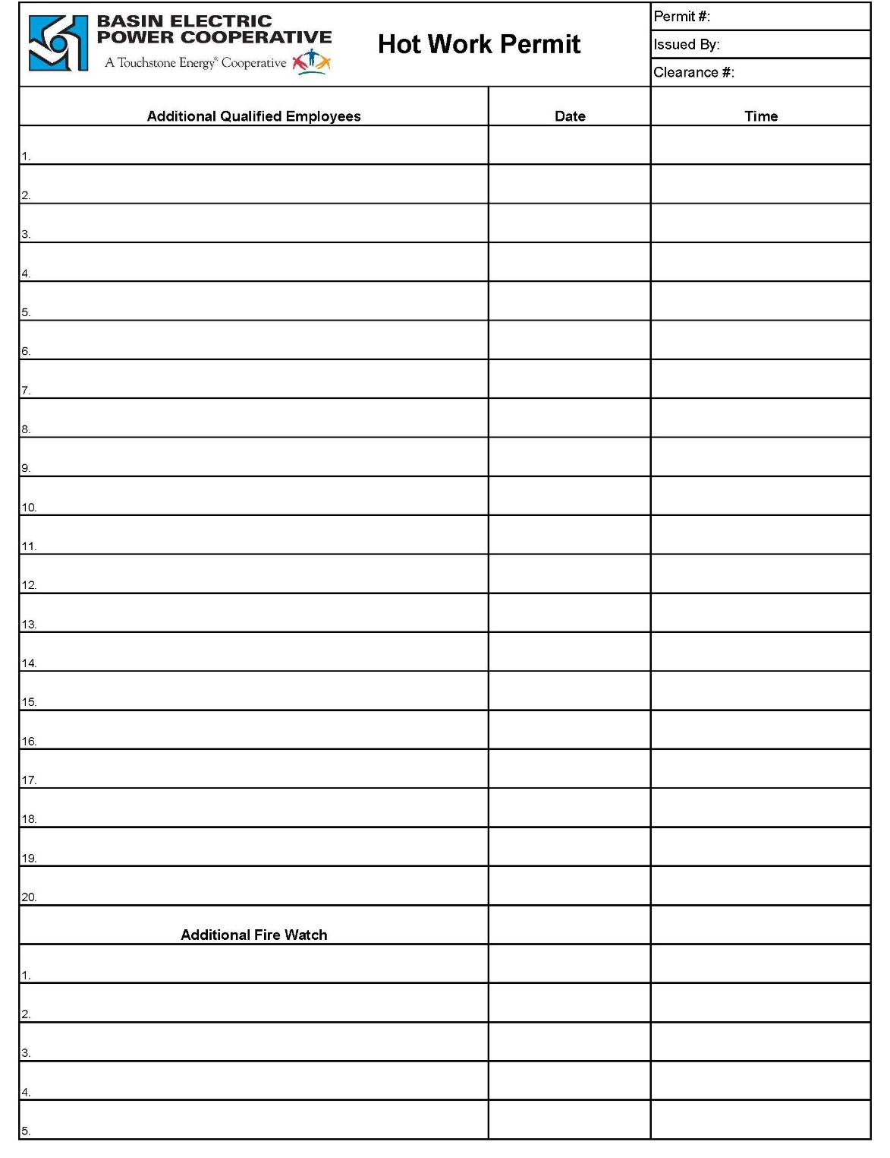
2nd Page

Slide 115

3rd Page

Slide 116
Portable Gas Monitors

Slide 117
Responsibilities
Checking out gas monitor equipment from the Operating Authority.
Properly fill out the multi-gas monitor checkout log.
Verifying calibration, bump test, and functional checks are complete.
Notifying the Operating Authority and/or supervisor if issues arise with gas monitors.
Knowing how to utilize gas monitoring equipment and asking questions if functionality is not understood.
Returning gas monitoring equipment to the Operating Authority when finished, an issue arises, or battery indicates the need for a charge.

Slide 118
MSA
AltAir 5X: Oxygen (O²), Lower Explosive Limit (LEL), Carbon Monoxide (CO), Hydrogen Sulfide (H²S), Sulfur Dioxide (SO²) and PID Anhydrous Ammonia (NH3)/VOC Sensor
AltAir 4XR: Oxygen (O²), Lower Explosive Limit (LEL), Carbon Monoxide (CO) and Hydrogen Sulfide (H²S).

Slide 119
Monitors
If contractors plan to utilize Basin’s air monitors, please review the Portable Gas Monitor Procedure that is posted online.
Advise your employees on the monitor operation and alarming techniques outlined in the procedure.
The VOC sensor needs to read 0% for anyone to enter a confined space.

Slide 120
ENVIRONMENTAL ORIENTATION

Slide 121
Environmental
Maintain Compliance : Air quality, storm water, spill prevention, solid and hazardous waste, wildlife.
Use best management practices, preventative maintenance and preventative measures.
Correct issues immediately and report them, as necessary.
Learn from mistakes to prevent them from repeating.

Slide 122
Questions to address
Will your job create outdoor dust?
This includes dust that is created indoors but can make it outside though a door or opening.

Slide 123
If you answered yes….
Will your job create outdoor dust?
Cease work until you discuss how your work can be done differently to prevent outdoor dust. This applies to the entire site except for the ash silo loadout and the ash landfill. These areas are permitted to have a very small amount of controlled dust.

Slide 124
Example
Moving lime to the ash landfill. Control the dust by….
Loading product indoors.
Covering the equipment while moving it to the ash landfill.
Using controls such as a water truck or sprinklers in the ash landfill.
Other examples include offloading trucks (don’t blow off the lines).

Slide 125
Questions to address
Are you bringing an unpermitted emission source onsite?
This may include:
Fuel burning equipment with a heat input of more than 25 million BTU/hr (6.25 billion gm-cal/hr)
Gaseous fuel containing more than 10 million BTU/hr (2.5 billion gm-cal/hr)

Slide 126
If you answered yes….
Are you bringing an unpermitted emission source onsite?
You will need to contact the WYDEQ for a waiver or temporary permit. Mobile internal combustion engines are exempt from this regulation.

Slide 127
Questions to address
Is your vehicle or equipment tracking dirt and dust?

Slide 128
If the answer is yes….
Is your vehicle or equipment tracking dirt and dust?
Discuss this with your On-Site Coordinator to minimize the spreading of dirt and dust around the plant site.
Can you take a different route?
Does your equipment need properly maintained?
Stay on asphalt as much as possible, stay off the limestone.

Slide 129
Example
If you are driving to and from the ash landfill, use the below best management practices to minimize dust (air quality issue) and runoff into the storm water system.
Wash the equipment on a regular basis (not on the plant site).
Keep to the same routes rather than tracking additional routes.
Clean spilled materials off the roads.

Slide 130
Questions to address
Did you have any type of spill or leak?
This includes very small amounts, less than a pint.

Slide 131
If the answer is yes….
Did you have any type of spill or leak?
This includes very small amounts, less than a pint.
All oil and chemical leaks or spills must be contained, cleaned up, reported, and disposed of immediately.
The spill forms are obtained from your On-Site Coordinator and must be returned immediately.

Slide 132
Examples
Oil from your vehicle.
Process water from your work.
Hydrated or pebble lime from offloading or moving it from one place to another.
Chemicals used in your job.

Slide 133
Spill Prevention
Use spill prevention equipment such as pigs and pads found in the warehouse.
Use storm drain covers found in the warehouse.
Do proper preventative maintenance on your equipment.

Slide 134
Spill Clean Up
Use appropriate media to clean the spill.
Hydrated lime can be used for acid spills.
Dirt or dual zorb (absorbent) for outdoor spills.
Call the Vacuum Truck.
Dispose of the spill and clean up material immediately.
Spill Report.

Slide 135
Questions to address
Are you going to have a 55-gallon drum of oil (gas, diesel, etc..) onsite?

Slide 136
If the answer is yes….
Are you going to have a 55-gallon drum of oil containing material onsite?
If so, additional SPCC rules apply, and you must get with your On-Site Coordinator to discuss compliance.
The drum does not have to be full to be subject to regulation.

Slide 137
Questions to address
Do you need water to perform your job?

Slide 138
If the answer is yes….
Do you need water to perform your job?
Do not use water from the Waste Water Pond. You may not use process water if it can get in a storm drain.
If you add any type of detergent, chemical, or process to any water onsite, it cannot go into a storm drain.
Discuss this with your On-Site Coordinator.

Slide 139
Examples
Water for dust control.
Water for work.
Water for washing.

Slide 140
Questions to address
Do all of your hazardous substances have a lid and a label?
What else does the hazardous substance need?

Slide 141
If the answer is no….
Do all of your hazardous substances have a lid and a label?
Find a lid and a label.
What else does the hazardous substance need?
Safety Data Sheet, SDS

Slide 142
Questions to address
Did you throw batteries, light bulbs (broken or whole), hazardous substances, or household waste in a DFS trash receptacle?

Slide 143
If the answer is yes….
Did you throw a batteries, light bulbs (broken or whole), hazardous substances, or household waste in a DFS trash receptacle?
Remove it from the trash receptacle and take it with you when you leave site. If it belongs to DFS ask your On-Site Coordinator for the proper disposal.

Slide 144
Questions to address
Are you planning to wash any equipment or vehicles onsite?

Slide 145
If the answer is yes….
Are you planning to wash any equipment or perform onsite?
This is prohibited, so cease work, and take equipment off the property to wash unless you can wash it indoors with permission from your On-Site Coordinator.

Slide 146
Questions to address
Are you doing vehicle maintenance onsite?

Slide 147
If the answer is yes….
Are you doing vehicle maintenance onsite?
Vehicle maintenance should be taken offsite to complete. Otherwise, it must be done indoors.
In outdoor maintenance emergencies, cover the drains, and use spill prevention before beginning the work.
You may find the spill prevention equipment in the warehouse.
Take the soiled products with you offsite for disposal.

Slide 148
Questions to address
Do you have a waste you want to take to the ash landfill?

Slide 149
If the answer is yes….
Do you have a waste you want to take to the ash landfill?
Do not take anything to the ash landfill without discussing it with the On-Site Coordinator first.
The only wastes allowed are coal combustion residue (ash), coal from drain sumps, and material from ponds.
Dust must be controlled at all times.
Permission needs to be granted to use the ash landfill outside of daylight hours.
Absolutely no trash is allowed.

Slide 150
Questions to address
Are you pumping water on site?

Slide 151
If the answer is yes….
Are you pumping water on site?
Discuss details with your On-Site Coordinator before allowing water to enter any outdoor drains.
Allowing process water to enter a storm drains are against regulations.

Slide 152
Questions to address
Are you using aerosol cans?

Slide 153
If the answer is yes….
Are you using aerosol cans?
Aerosol cans must be stored with a lid in a flammable cabinet, you must have a copy of the SDS, and you must take it with you when you leave.
If you are using Dry Fork Station’s aerosol cans, make sure the empty ones end up in the warehouse in the proper disposal area.
Do not throw any aerosol can away in the trash.
Do not put them in the boiler.
Do not leave them sitting around.

Slide 154
Questions to address
Did you see injured or dead wildlife?

Slide 155
If the answer is yes….
Did you see injured or dead wildlife?
Report this to your On-Site Coordinator immediately.
Do not handle, chase, move, or disturb any wildlife.
Do not feed the wildlife.

Slide 156
Environmental Summary
Compliance is mandatory.
On-Site Coordinators are here to help.
If you don’t know the answer, ask!!

Slide 157
TRAINING DOCUMENTATION

Slide 158
Training Documentation
All Employees need the following turned in:
Contractor Employee Training Record SAF-6020
General Safety and Environmental Rules Form SAF-6051
Only those employees signing on a Clearance need the following:
Clearance Authorization SAF-6035
Once on-site, only those riding the Belt Manlift need:
Belt Manlift Certification Record SAF-6029
Only those borrowing and operating DFS mobile equipment need:
Contractor Mobile Equipment Training Verification SAF-1602
This must be in the contract and/or authorized by the On-Site Coordinator

Slide 159
Training Records
Please send all training records and employee headshot pictures to:
DFSIDCARD@BEPC.com and your On-Site Coordinator
If you have questions, ASK!!
On-Site Coordinator
Operating Authority
Safety Coordinator
At the morning meeting

Slide 160
Final Expectations
Do the Right Thing and Ask Questions​.
Clean your work area throughout the day, the wind comes up very quickly and strong, so secure supplies outside.​
Keep all truck and man doors closed.
Turn in all permits as required.
Sign off clearances when work is finished.
Contractors, you are responsible for the safety of your employees, subcontractors, coworkers and any other persons on the site related to your project and activities.
BE SAFE! ​Your families are waiting for you at home!

Slide 161
Welcome to Dry Fork Station

